Slide 1
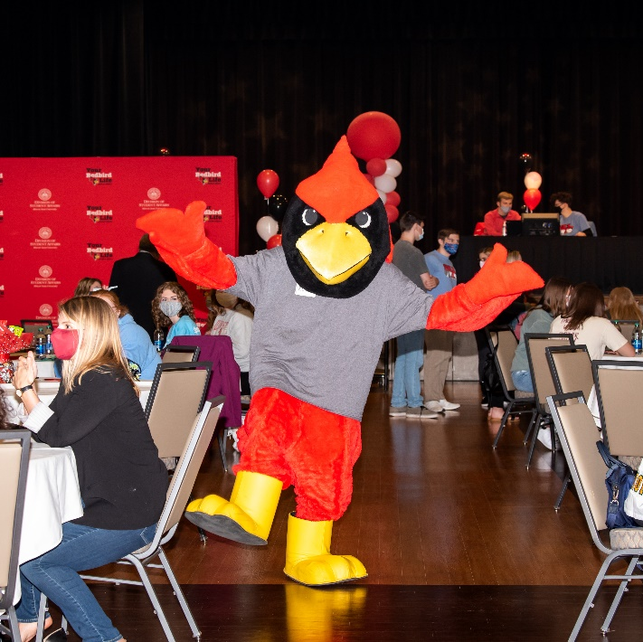
RSO
Orientation 2023-2024

Slide 2
STAY INFORMED!

Slide 3
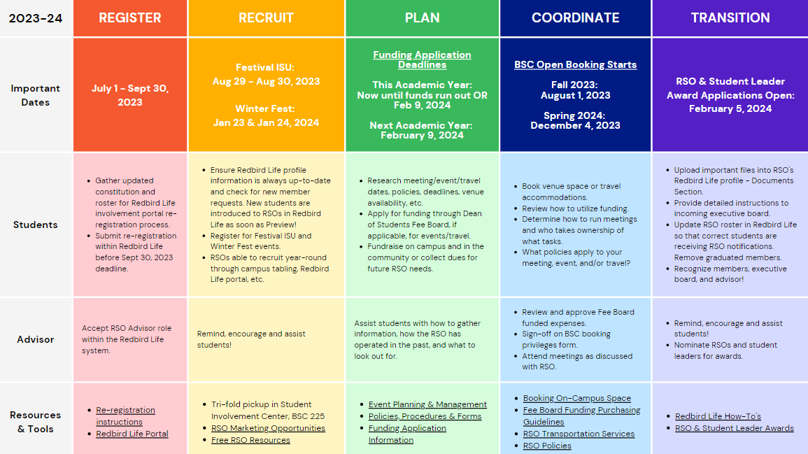
2023-2024 RSO Calendar

Slide 4
Campus Policies/Procedures
Amplification
Contracts
Event Insurance
Event promotion
Events with Alcohol
Film copyright/subtitles
Fleet
Food Permit
Funding / Fundraising
Open External Bank Account
Protection of Minors on Campus
Raffles
RSO Classification
Space reservation
For more information, visit our:
Policies and Procedures webpage -
https://deanofstudents.illinoisstate.edu/involvement/organizations/policies/
Event Planning webpage–
https://deanofstudents.illinoisstate.edu/involvement/organizations/event-planning/

Slide 5
FREE RSO RESOURCES
Supplies
Trifold – 1 per RSO/year
Pens
Mini Pads of Paper
Art Supply Kits
Chalk the Quad Kits
Board Games
Student Involvement Center
Fall & Spring: M – F 8 am to 6 pm
Summer: M – F 8 am to 4:30 pm
Computers with Adobe Creative Suite
Conference Table Space with a Large Screen
15 Copies per RSO/Day
24 Customized Buttons per RSO/semester
RSO Mail Pick-up (held for 30 days)
Bulk Paper Cutter
General Table Seating
Digital Marketing
Digital Display Screens
Outside Student Involvement Center
RSO Newsletter
Redbird Life Portal

Slide 6
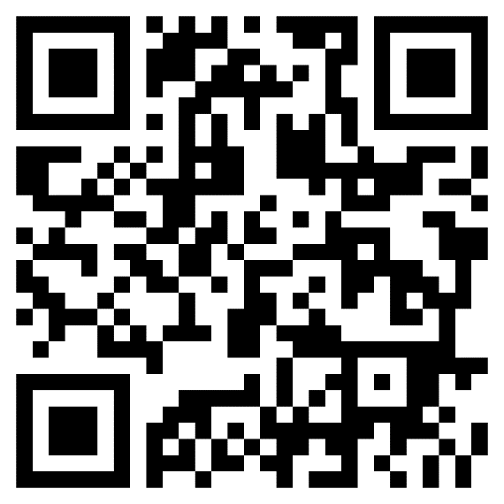
Redbird Life
Scan to Access
Notes:
Now that we’ve talked about what involvement is and ways to get involved, let’s talk about where to find the information. Encourage students to scan the QR code, take a picture of the slide, or go to the website. Give them time to do that. Switch to Redbird Life on a web browser. Show the organizations tab and the events tab. You can ask students if they have a category of RSOs they’re interested in, then go to that category to show the room some of the RSOs that fit under that category.

Slide 7
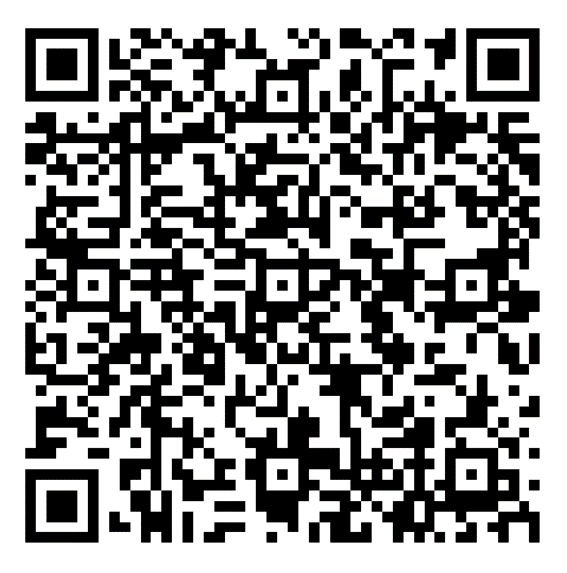
Redbird Life
What can I do on Redbird Life?
Features
Roster Management
Event Creation
Attendance tracking
Forms/Signups
News Articles
AND MORE!
Scan to Access
Redbird Life How-To Guides
Notes:
Now that we’ve talked about what involvement is and ways to get involved, let’s talk about where to find the information. Encourage students to scan the QR code, take a picture of the slide, or go to the website. Give them time to do that. Switch to Redbird Life on a web browser. Show the organizations tab and the events tab. You can ask students if they have a category of RSOs they’re interested in, then go to that category to show the room some of the RSOs that fit under that category.

Slide 8
Redbird Life Home Page

Slide 9
How to Use Redbird Life
Access your RSO

Slide 10
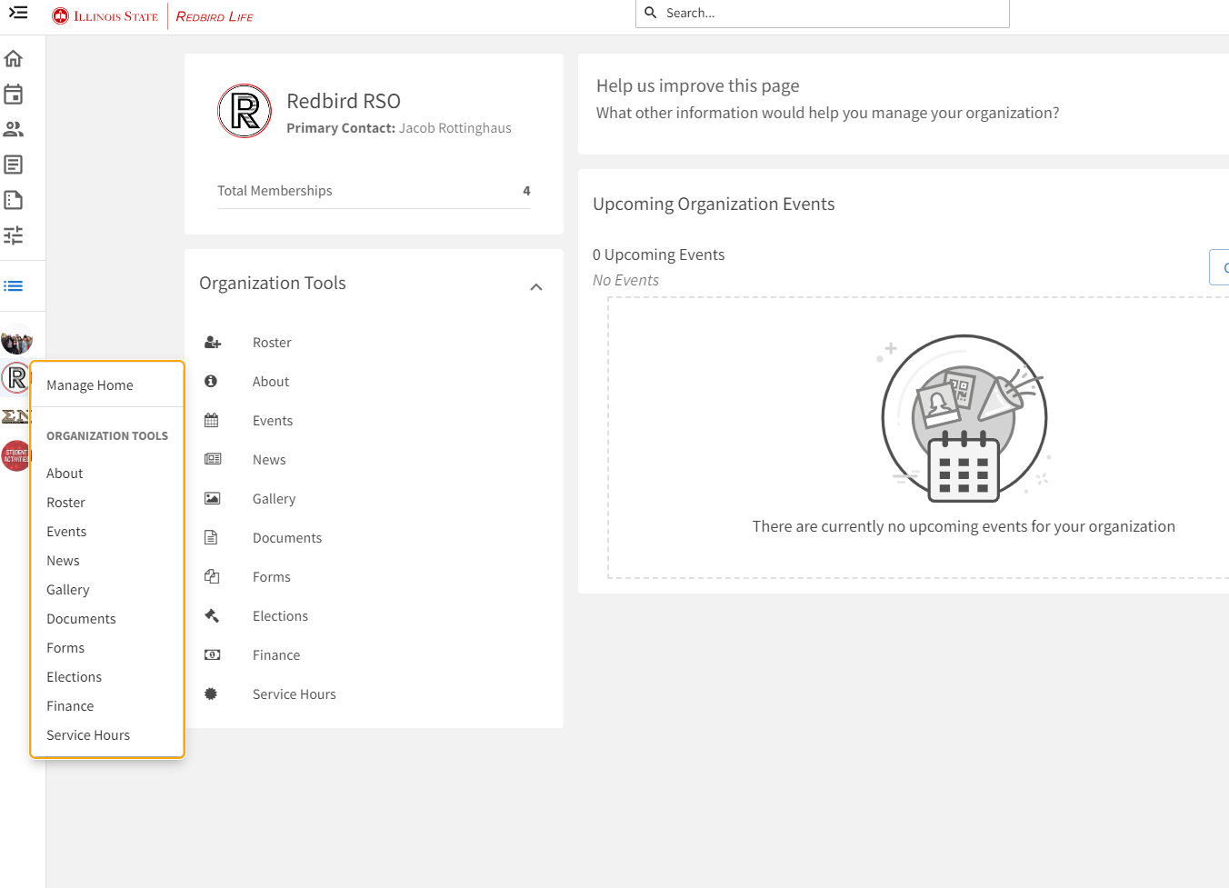
How to Use Redbird Life
Organization Tools
Roster Management
Event Creation
Forms/Signups
News Articles
AND MORE!

Slide 11
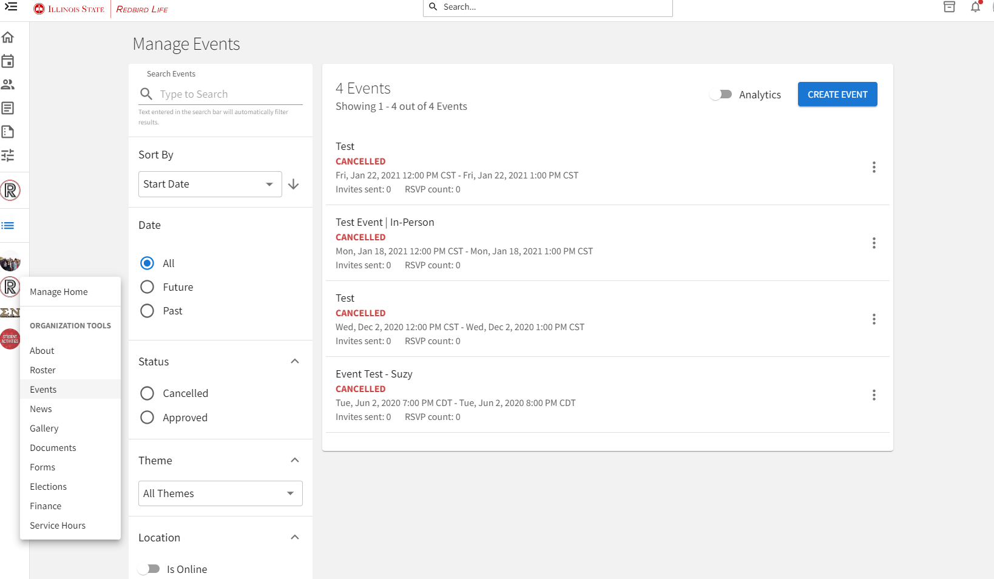
How to Use Redbird Life
Create events!

Slide 12
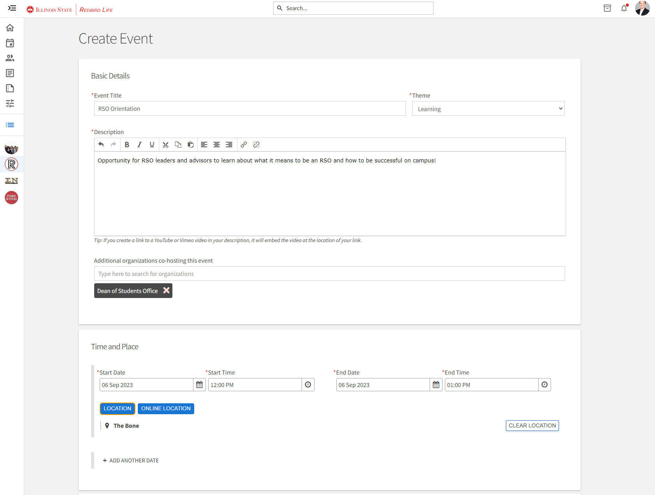
How to Use Redbird Life

Slide 13
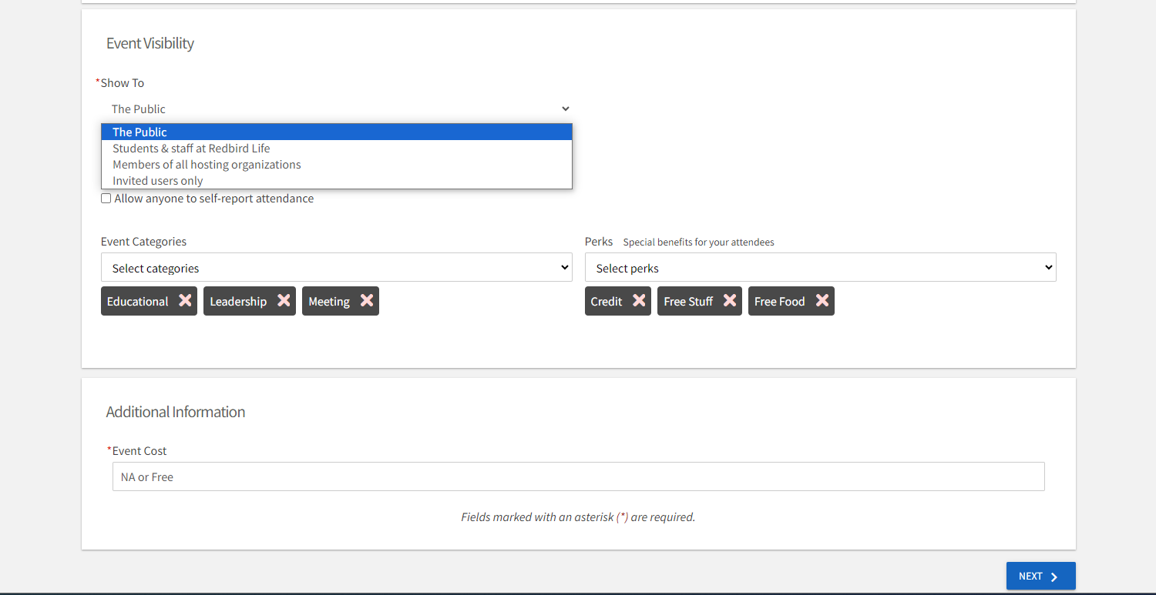
How to Use Redbird Life

Slide 14
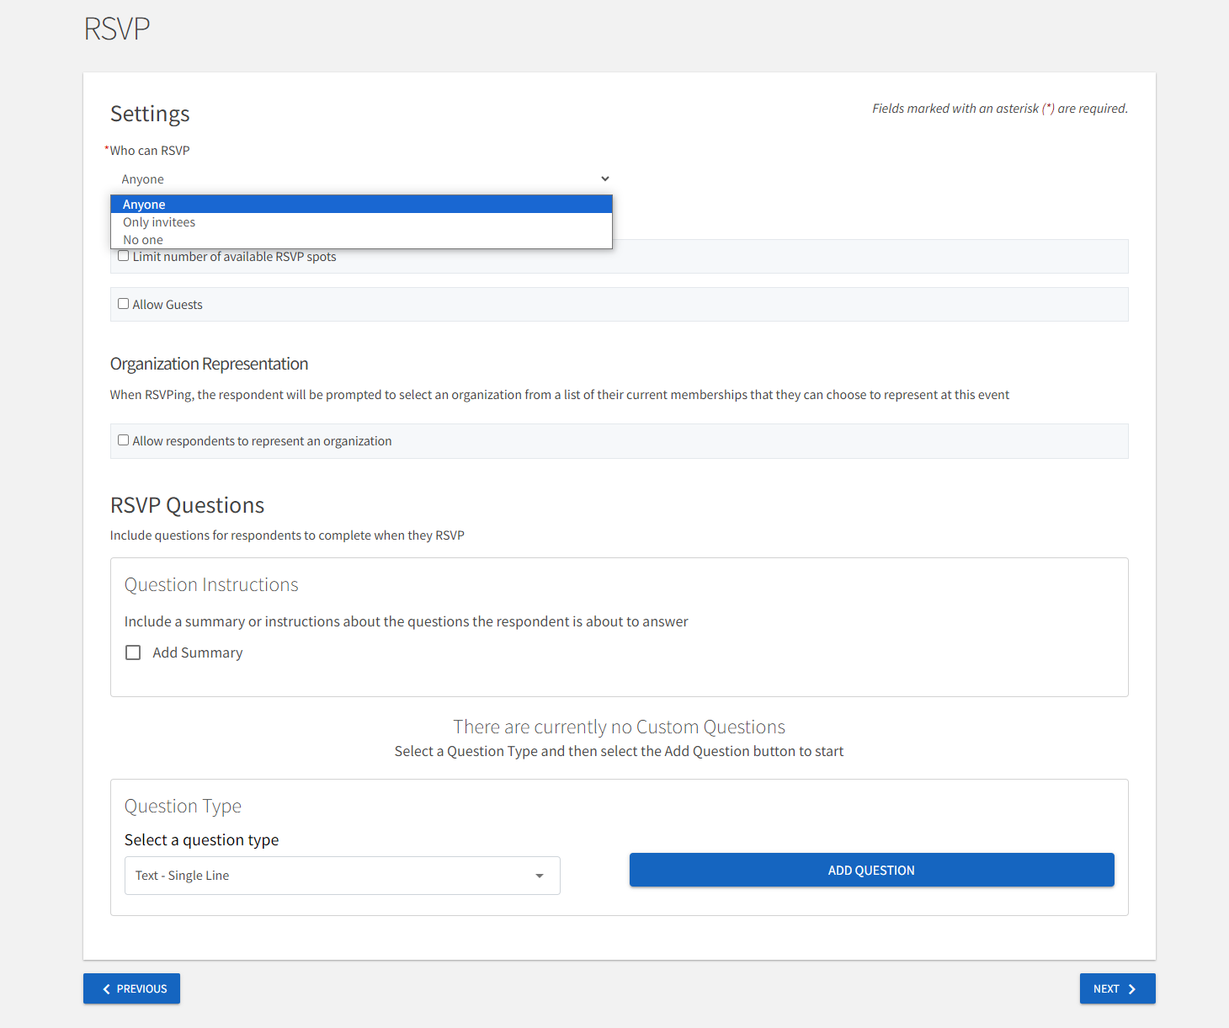
How to Use Redbird Life

Slide 15
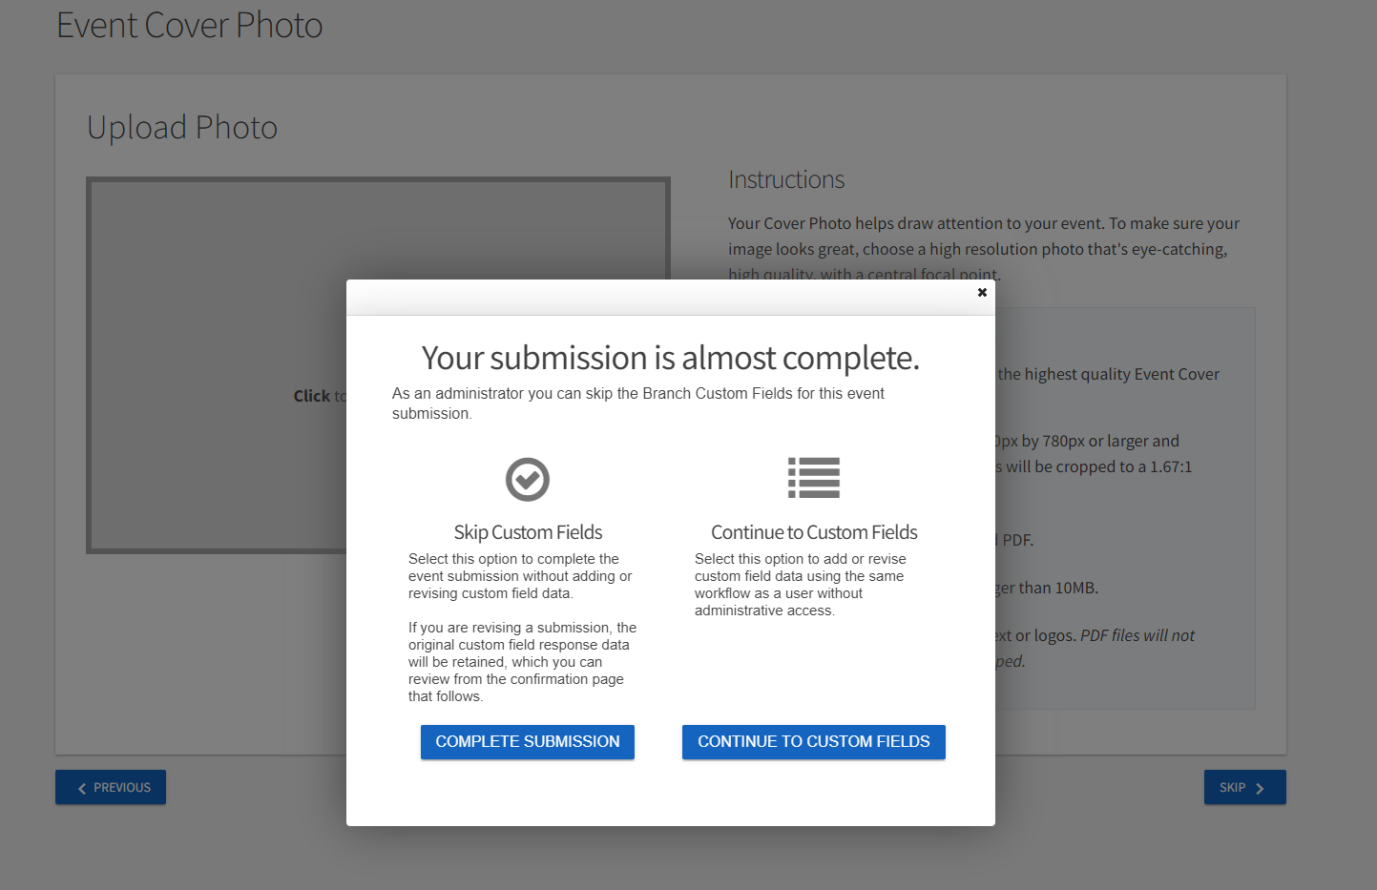
How to Use Redbird Life

Slide 16
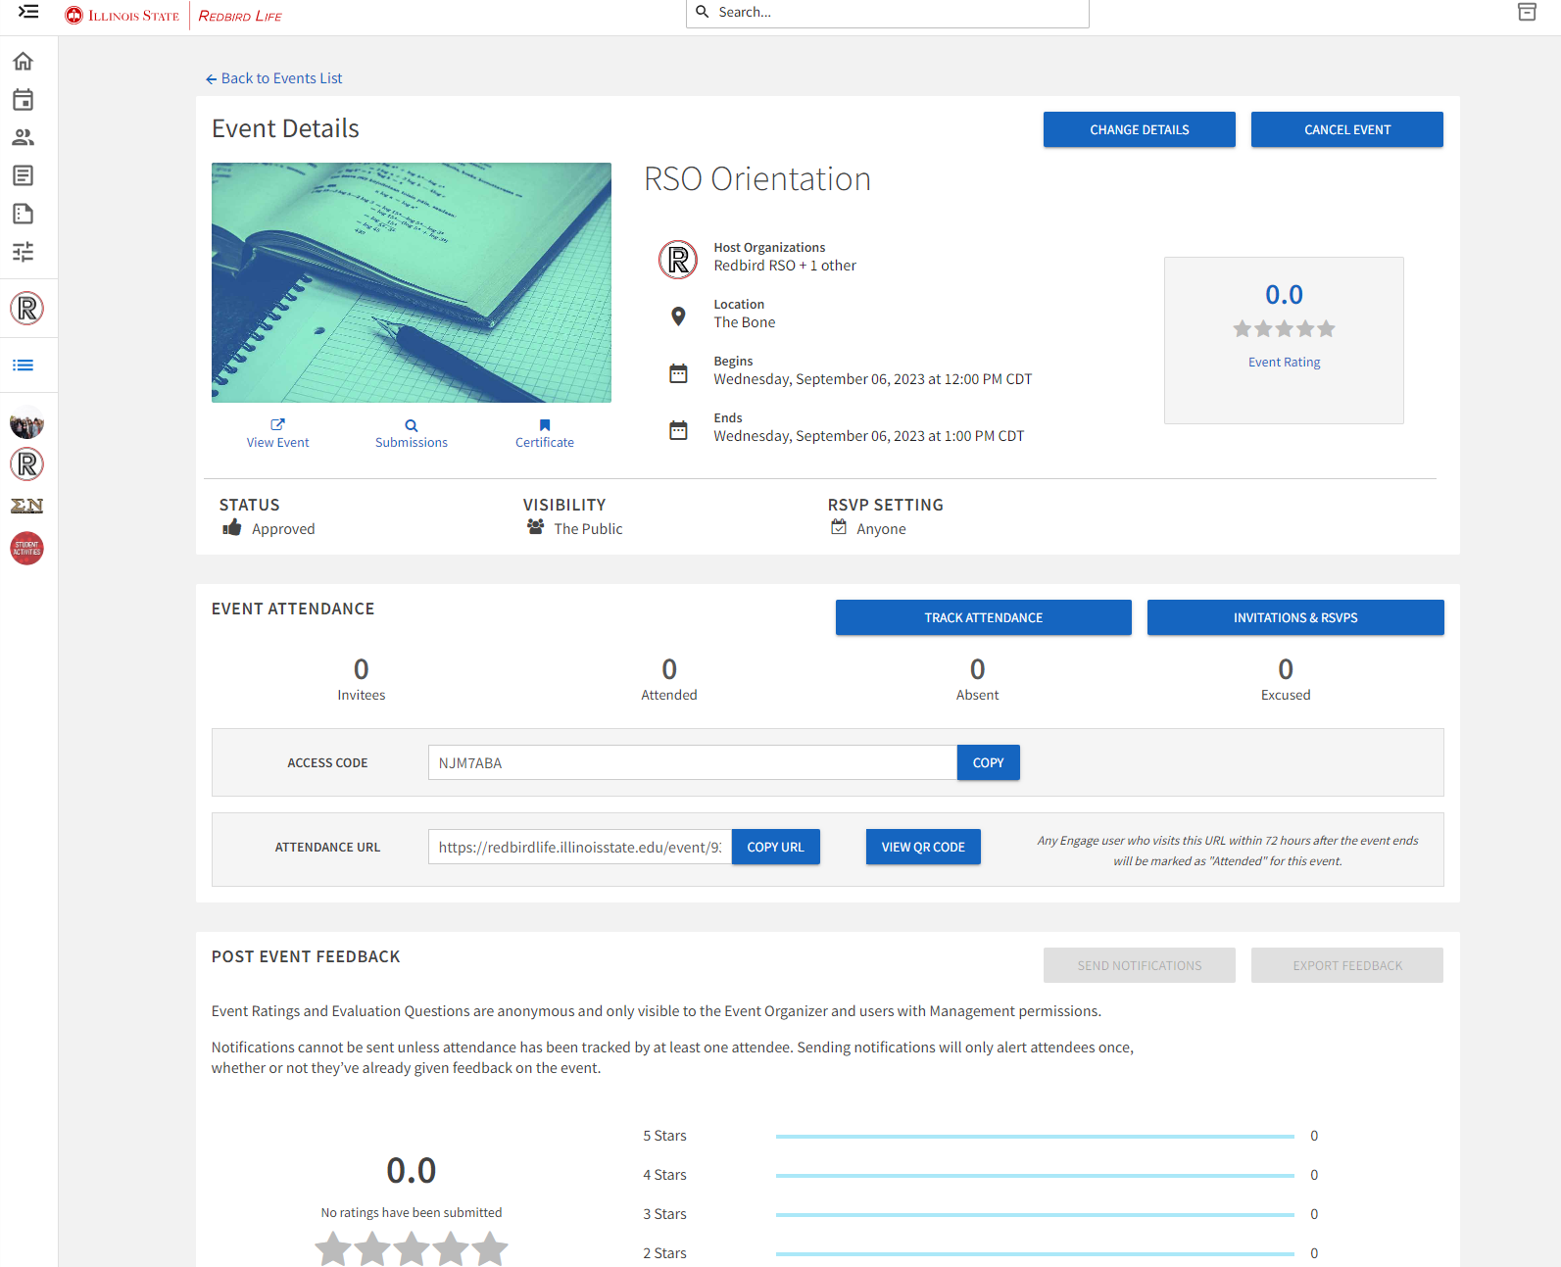
How to Use Redbird Life

Slide 17
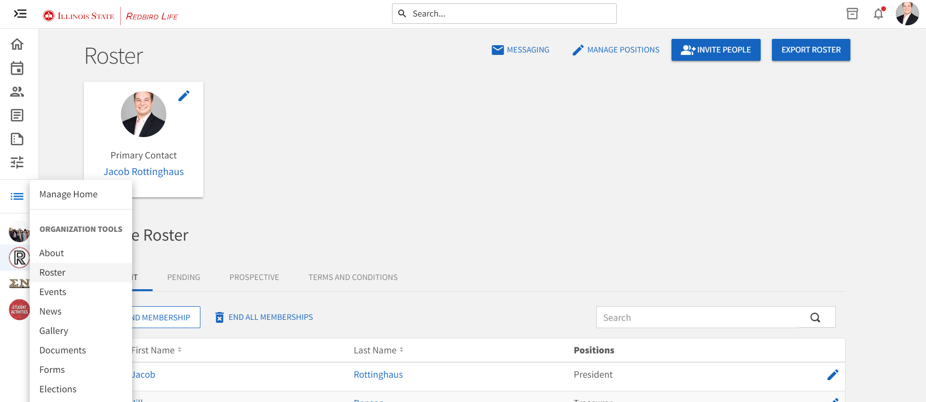
How to Use Redbird Life

Slide 18
How to Use Redbird Life
Track attendance at your meetings and events.
Download Event Check-in App!
Learn more at the Student Organizations Resources webpage:
https://deanofstudents.illinoisstate.edu/involvement/organizations/resources/

Slide 19
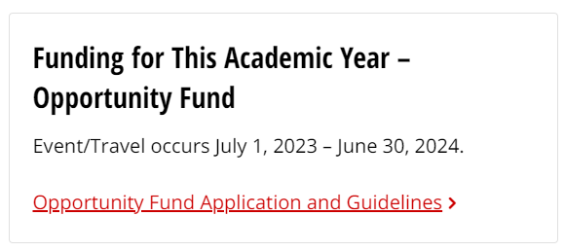
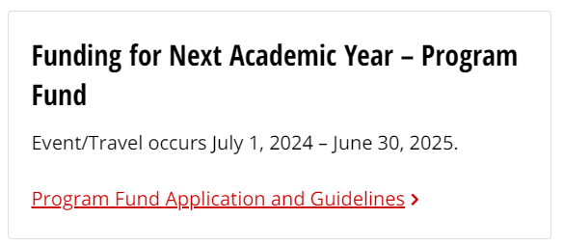
RSO Funding
Did you know?
Funding
Independent RSOs
Sponsored RSOs
Certain limitations
Contact
Heather Marshall
RSO Financial Associate
hllough@IllinoisState.edu

Slide 20
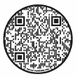
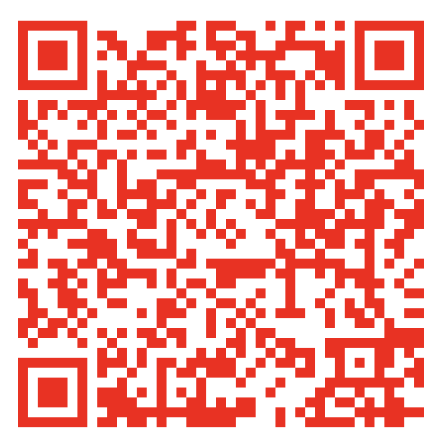
Book Rooms on Campus
The Bone Student Center
Reserving Space
MUST have a booking privileges form on file with the Bone Student Center
Submit an event reservation request via the online booking form
Pay attention to your University email for messages from Event Management, Dining & Hospitality staff regarding your reservation
Scan to Access
Booking Privileges form
Scan to Access
Event Request Form
Learn more at the Bone Student Center Website:
https://bonestudentcenter.illinoisstate.edu/scheduling/

Slide 21
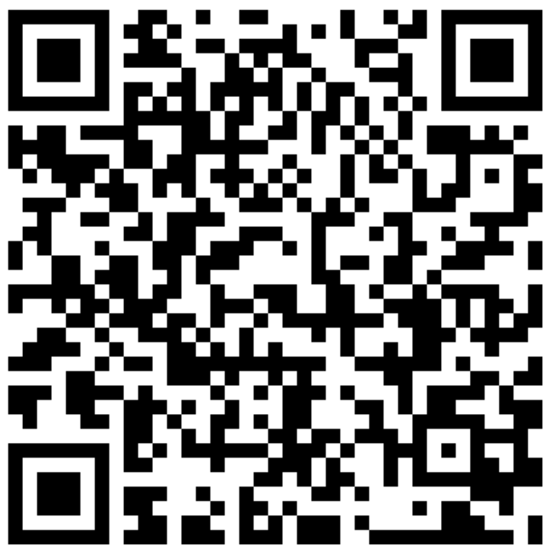
Book Rooms on Campus
Academic & Non-Academic Rooms
Reserving Space
Contact Conference Services
Review the options
Email or call the appropriate person
Receive room confirmation and details
Enjoy your event!
Learn more at the Conference Services webpage:
https://conferences.illinoisstate.edu/scheduling/

Slide 22
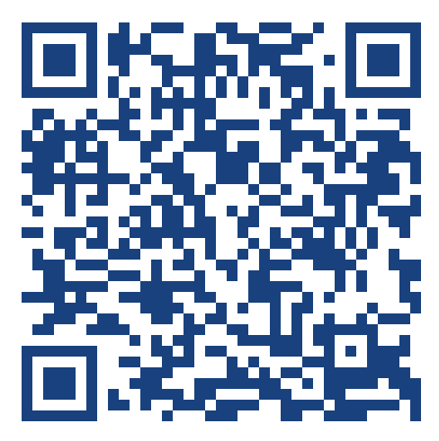
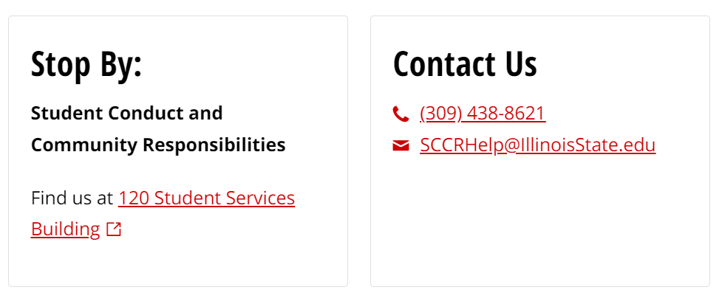
Code of Conduct
Applies to Individuals & RSOs
Complete Code of Student Conduct available at https://deanofstudents.illinoisstate.edu/conduct/code/
Scan to Access
Code of Conduct

Slide 23
Code of Conduct
Hazing
Page 11:
V iolations include such behavior as:
Engaging in any act that endangers the mental, emotional, or physical health or safety of a student for the purpose of initiation into, affiliation with, or continued membership in any group, organization, or team whose members are or include students of Illinois State University.
Engaging in any act where an individual is encouraged to engage in conduct of an unbecoming or humiliating nature, or which in any way detracts from an individual’s academic pursuits for the purpose of initiation into, affiliation with, or continued membership in any group, organization, or team whose members are or include students of Illinois State University.
Engaging in any acts such as paddling (using a paddle to strike another individual), physical punishments, creating excessive fatigue, work sessions, physical or emotional shock, wearing apparel which is conspicuous and not in good taste, public stunts, morally degrading or humiliating games or events, of that encourage the illegal and/or abusive use of alcohol and/or other drugs.
Failing to prevent, and/or failing to discourage, and/or failing to report known acts of hazing as a member of an organization participating in such activities when these activities are known to be taking place, or where it should be reasonably known that such activities are taking place.
For the purpose of this policy, hazing includes any activity that is inconsistent with regulations or policies of Illinois State University or the laws of the State of Illinois for the purpose of initiation into, affiliation with, or continued membership in any group, organization, or team whose members are or include students of Illinois State University. Acts of this nature are considered to be hazing whether or not a person willingly participates in such activities.

Slide 24
Illinois State Law
Hazing
Statue 12C-50
A person commits hazing when he or she knowingly performs an act, or causes a situation, that recklessly or intentionally subjects a student or other person in a school, college, university, or other educational institution of this State, to the risk of bodily harm for the purpose of induction or admission into any group, organization, or society associated or connected with that institution, if: (1) the act or situation is not sanctioned or authorized by that educational institution; and (2) the act results in bodily harm to any person

Slide 25
What Do I do?
Hazing
Unsure if it’s hazing?
Ask the Student Activities Office to review the situation.
Consider what value is added to your organization/event through the activity?
Need to report hazing?
If you believe there is hazing happening in your group, report it to
Student Conduct and Community Responsibilities at:
https://ilstu-advocate.symplicity.com/public_report/index.php/pid673310

Slide 26
RSO Re-Registration

Slide 27
Frequently Asked Questions
Why was my re-registration denied?
Non-discrimination clauses – need to be updated
Membership – needs to say 100% of members are from ISU
Ratification date – must be within the last two years
When can I expect to hear a status update?
It may take our office up to fifteen (15) business days

Slide 28
Need Assistance?
Feel a little lost…or want more info on an RSO topic?
We can meet with you and/or your RSO for a more in-depth discussion based on your RSO’s needs!
CONTACT US
Email: studentorgs@IllinoisState.edu
Or
Phone: (309) 438-2151

Slide 29
Questions?
Student Activities Office Contact Information
Website: Deanofstudents.illinoisstate.edu/involvement/organizations
Email: StudentOrgs@IllinoisState.edu
Phone Number: (309) 438-2151
Student Involvement Center:
227 Bone Student Center
August-May,
Monday-Friday: 8 am-6 pm
Social Media:
Facebook: Redbird Life
Instagram: Redbird_Life

Slide 30
Questions?

Slide 31
Thank you!
We can’t wait to see all the amazing things you accomplish this year!

