Slide 1




RSO Orientation
2025-2026
Notes:
Introductions: Names, Pronouns, and RSO
Introduce yourself: who you are, your role
Make a comment about the wide variety of student orgs and how amazing it is that we all have different missions but exist for the same purpose, to create our passions

Slide 2

Overview
Topics to Discuss
General Resources & Support
RSO Calendar
Campus Policies
Code of Student Conduct
Redbird Life
RSO Funding
Reserving Space on Campus
How to get support
Notes:
Run through the agenda
Is a small group can let them know it can be more discussion based
ASK QUESTIONS as needed

Slide 3
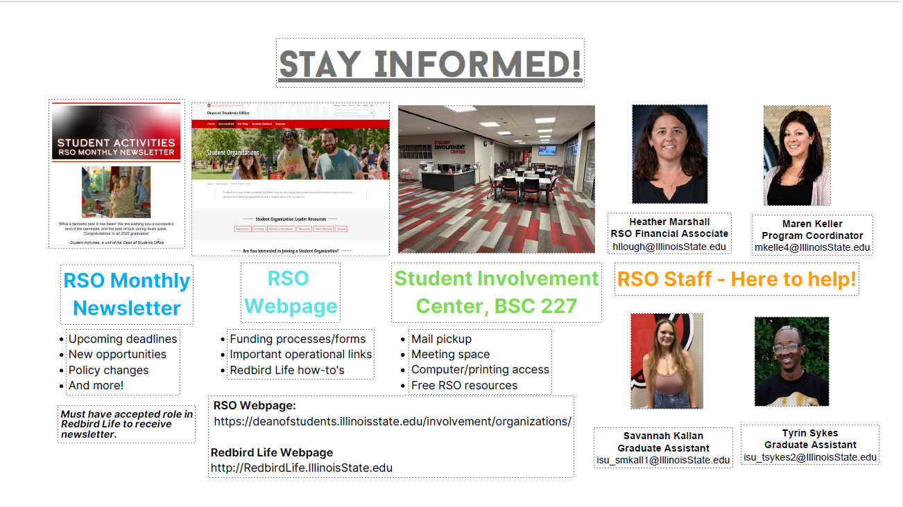
Stay Informed
Notes:
Highlights
Newsletter – goes to President, Treasurer, and Advisor which includes…. (read the slide)
Webpage – is the answer for everything (almost)
SIC – ask who has been there before (just for fun) then say where it is
Staff – primary folks that work with you on projects

Slide 4
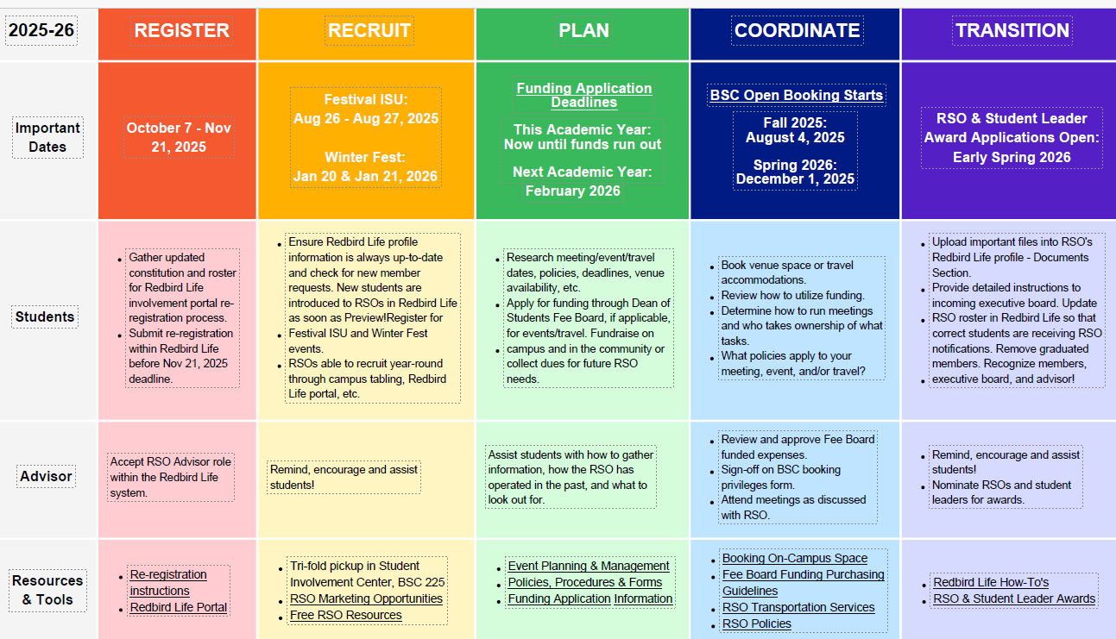
RSO Calendar
Notes:
Chunk the year down so it feels more manageable
Talk about each section
“we are living in the register/recruit right now” but we should always do the other three

Slide 5
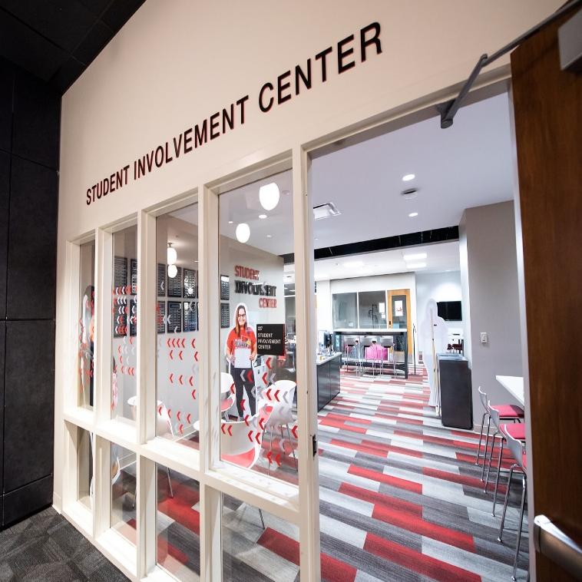
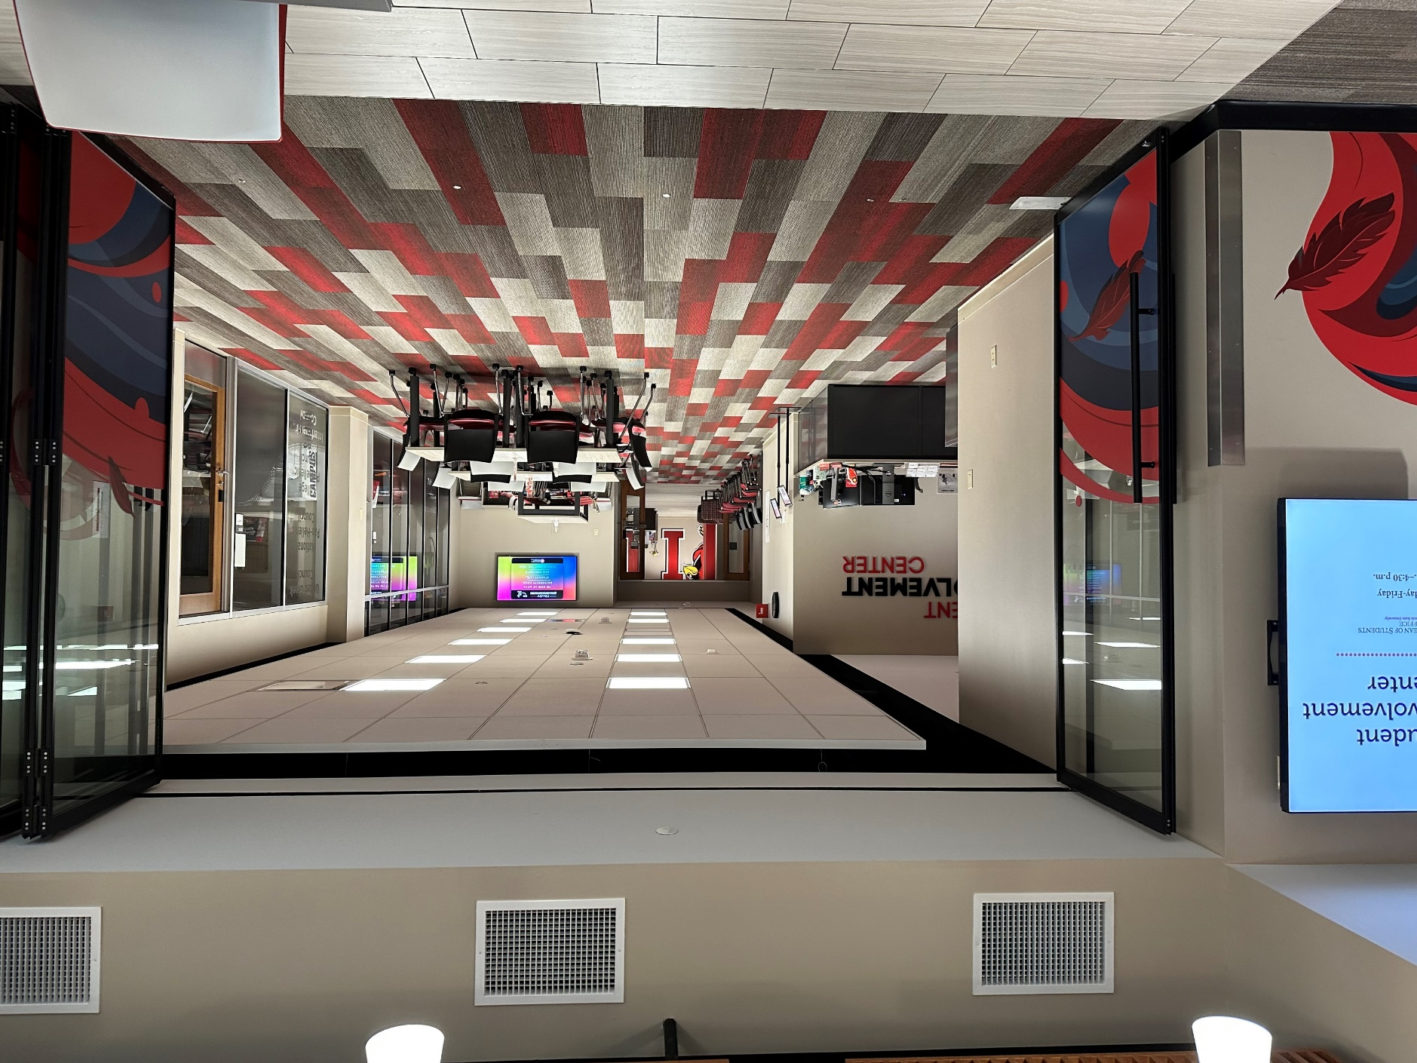
Student Involvement Center
In the Bone Student Center

Slide 6
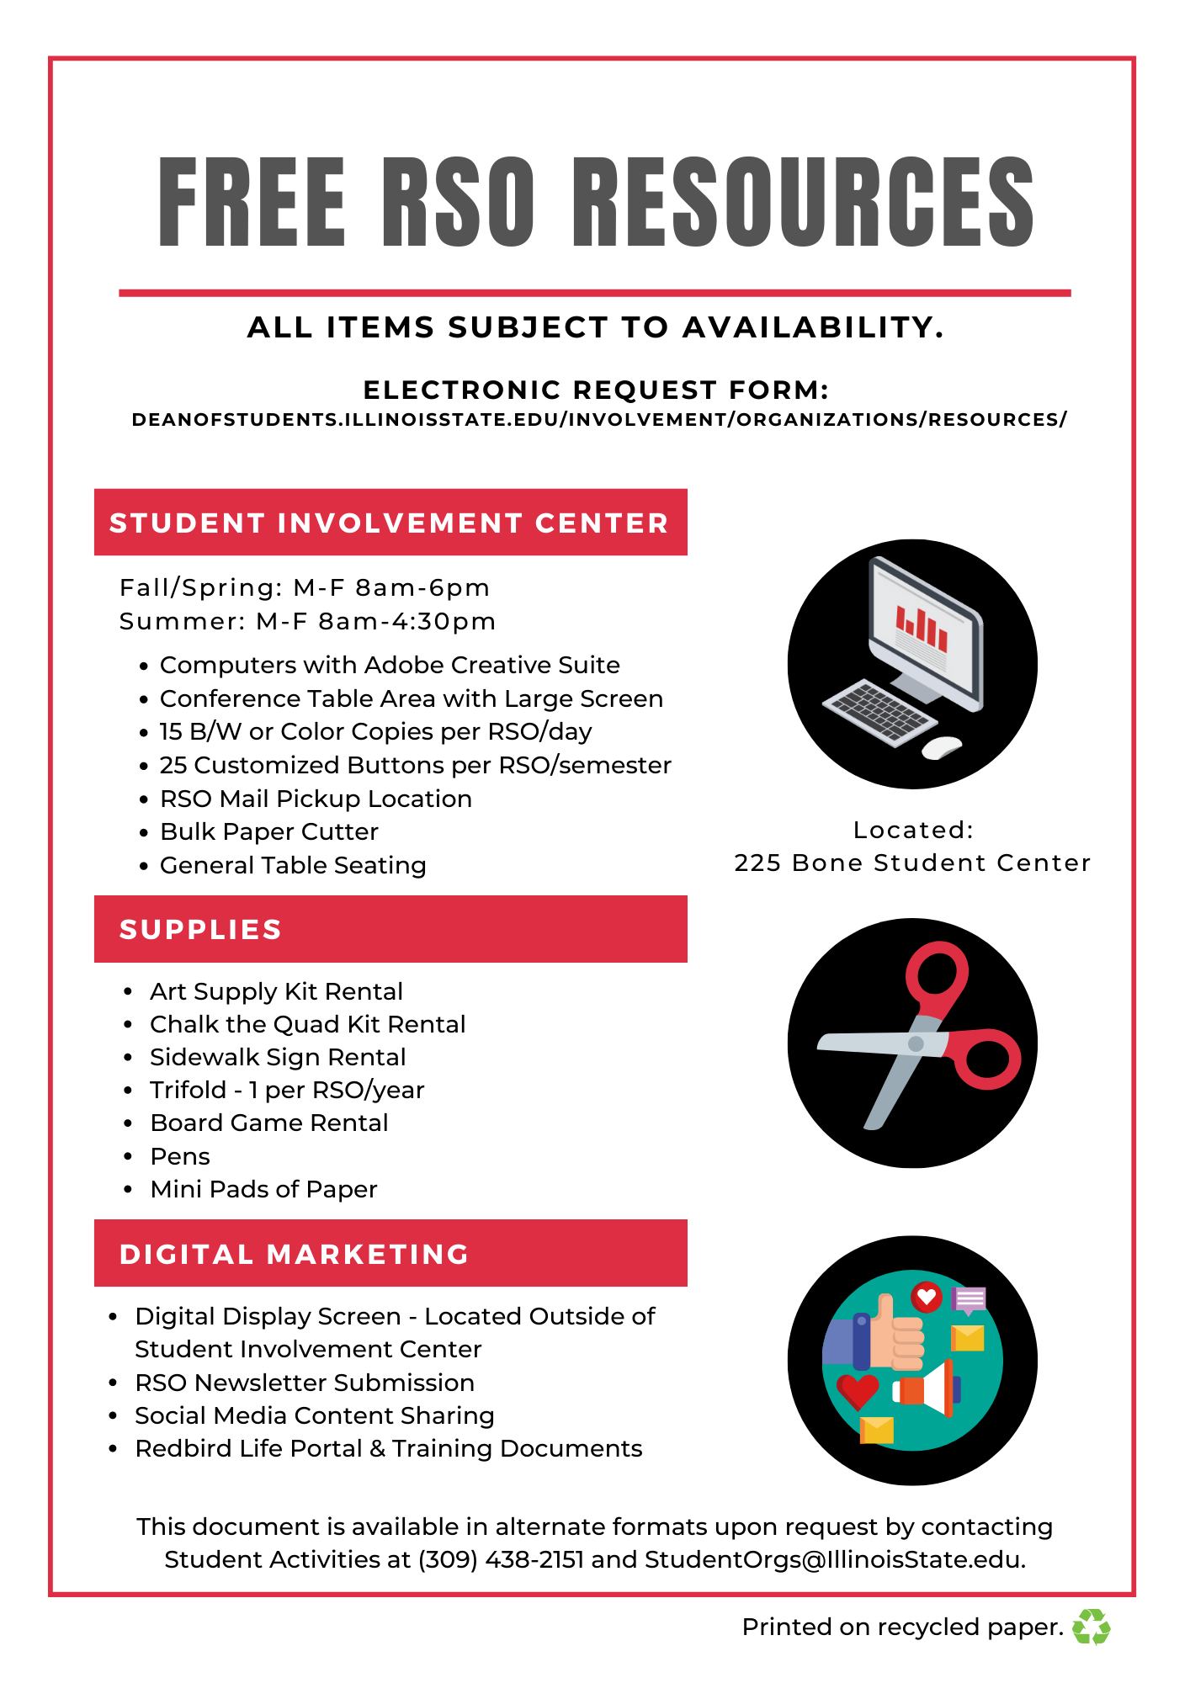
FREE – RSO Resources
Supplies
Trifold – 1 per RSO/year
Art Supply Kits
Chalk the Quad Kits
Board Games
Student Involvement Center
Fall & Spring: M – F 8 am to 6 pm
Summer: M – F 8 am to 4:30 pm
  Computers with Adobe Creative Suite
  Conference Table Space with a Large Screen
  15 Copies per RSO/Day
  24 Customized Buttons per RSO/semester
  RSO Mail Pick-up (held for 30 days)
  Bulk Paper Cutter
  General Table Seating
Digital Marketing
Digital Display Screens
  Outside Student Involvement Center
RSO Newsletter
Redbird Life Portal
Notes:
Highlight some of the resources

Slide 7

Campus Policies & Procedures
Policies to Acknowledge
Amplification
Contract
Event Insurance
Event Promotion
Events with Alcohol
Film copyright/subtitles
Fleet
Food Permits
Funding/Fundraising
External Bank Accounts
Protection of Minors on Campus
Raffles
RSO Classification
Space reservation and use
For more information, see the Student Organizations website
deanofstudents.illinoisstate.edu/involvement/organizations/policies
To review the specific policies and expectations, see the University Policies website
policy.illinoisstate.edu
Notes:
Highlight some of the policies (the ones that might be forgotten, or most likely to impact)
Amplification
Events with Alcohol
Copyright
Fleet
Food
Protection of Minors
Space res and use (also on next slide)

Slide 8
Campus Policies & Procedures
Policy 6.1.1 - Space Reservation & Use
The quad is available for general use but requires a reservation for events/activities sponsored/hosted by RSOs.
Classrooms, meeting facilities, theatres and auditoriums, athletic and recreational facilities, and other outdoor University spaces typically require advance registration.
The University will not interfere unless participants engage in the following behaviors:
Disrupt or prevent a function or activity
Injure persons, damage or destroy property, or threaten to cause injury
Create safety hazards or jeopardize the safety of others
Construct structures on university grounds without prior authorization
For more information, see the Student Organizations website
deanofstudents.illinoisstate.edu/involvement/organizations/policies
To review the specific policies and expectations, see the University Policies website
https://policy.illinoisstate.edu/facilities/6-1-1/
Notes:
Emphasis the first bullet point
Cover when the campus would prevent an event

Slide 9
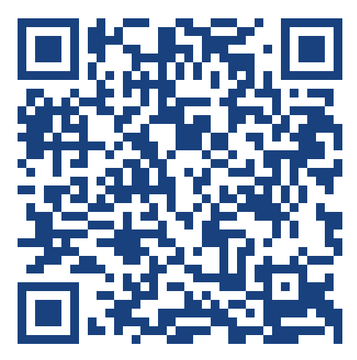
Code of Student Conduct
*This applies to Individuals & RSOs*
Complete Code of Student Conduct available at deanofstudents.illinoisstate.edu/conduct/code
Stop by:
Student Conduct
Student Services Building, Office 120
Contact:
Phone: (309) 438-8621
Email: StudentConduct@IllinoisState.edu
Scan to Access
The Code of Student Conduct
Notes:
Mention this is a thing, and applies to students and the RSO
Reference this is also where the academic dishonesty/drug & alcohol policies are so would be good for all members to see

Slide 10
Code of Student Conduct
Hazing
RSO leaders and members should access the online training: Hazing Prevention 101: It’s Everyone’s Responsibility
5.1.13 Anti-Hazing
V iolations include such behavior as:
Engaging in any act that risks the mental, emotional, or physical health or safety of an individual;
Causing, coercing, or otherwise inducing sleep deprivation, causing excessive fatigue, exposure to the elements, confinement in a small space, extreme calisthenics, or other similar activity;
Causing, coercing, or otherwise inducing another person to consume food, liquid, alcohol, drugs, or other substances;
Causing, coercing, or otherwise inducing another person to perform, sexual acts;
Any activity that places another person in reasonable fear of bodily harm through the use of threatening or intimidating words or conduct;
Any activity against another person that includes a violation of law;
Any activity that induces, causes, or requires another person to perform a duty or task that involves a violation of law;
Being party to, or complicit in, the encouraging or requiring of an individual to behave in any way that detracts from the individual's academic pursuits or employment responsibilities;
Causing, coercing, or otherwise inducing others to engage in acts such as work sessions, perform services or servitude (personal, physical, or financial), wear apparel which is conspicuous or not in good taste, perform public stunts, and/or perform acts that may be considered unbecoming or humiliating; or
Failing to prevent, discourage, or report acts of hazing when they are known or reasonably should be known to have taken place.
deanofstudents.illinoisstate.edu/conduct/code
Notes:
Make a comment about how we have to talk about hazing, but we should all know what is is
Look at point C for examples

Slide 11
Conduct – What to Do?
Is it hazing?
Ask the Student Activities Office to review the situation with you.
Consider, what is the value added to your organization/event through the activity?
Need to report hazing or other conduct-related situations?
Make a report to Student Conduct via the Public Incident Report form.
Notes:
When in doubt, submit a report

Slide 12
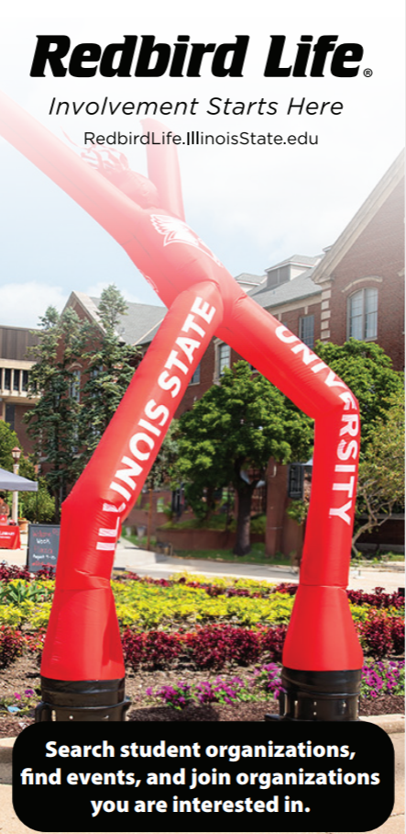
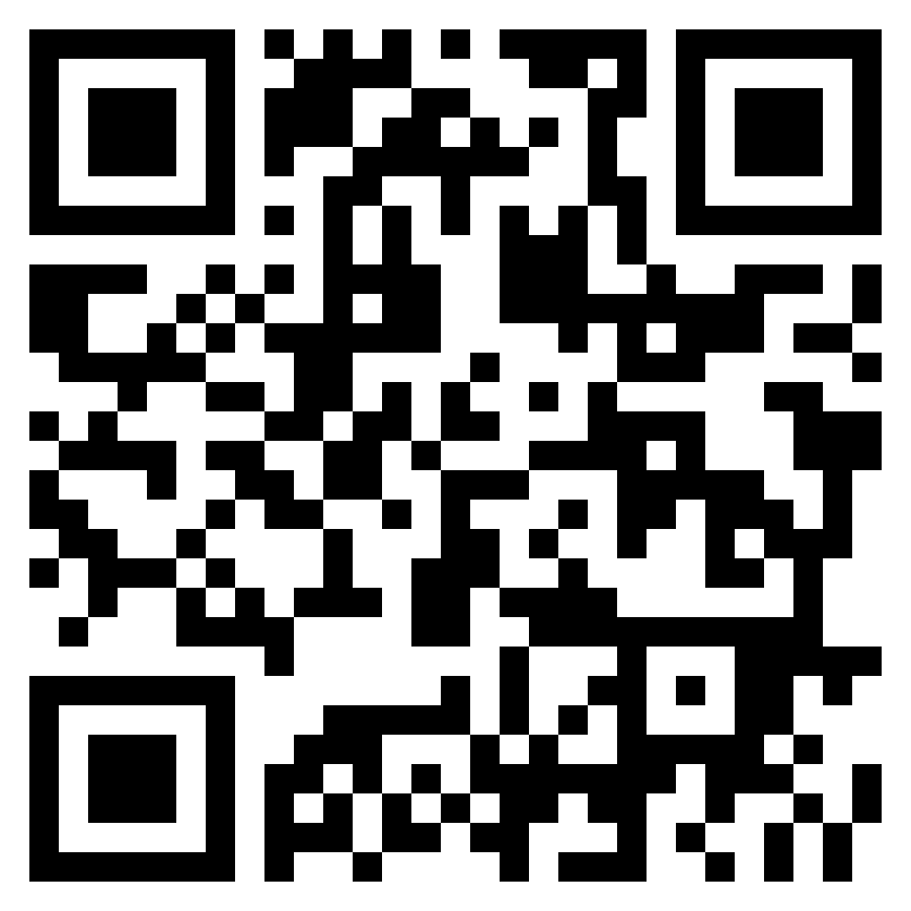
Redbird Life
Scan to Access
https://redbirdlife.illinoisstate.edu/
Notes:
The Student Involvement platform
Reference how most students now look for things to do on Redbird Life
Ask if everyone has used it before? This should be a YES

Slide 13

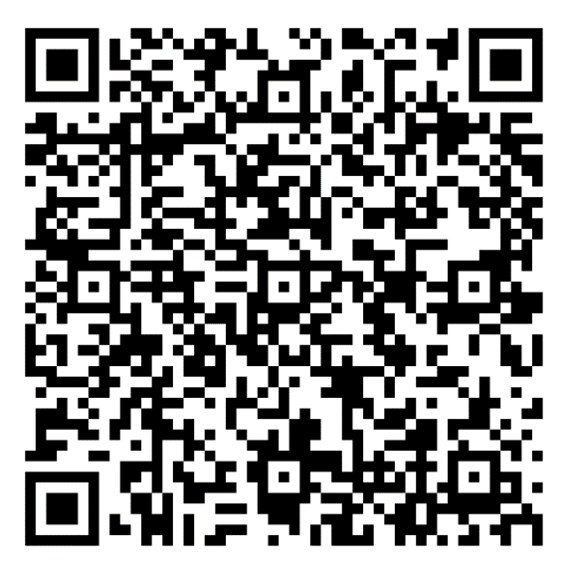

Redbird Life
What can I do on Redbird Life?
Features
Roster Management
Event Creation
Attendance tracking
Forms/Signups
News Articles
AND MORE!
Scan to Access
Redbird Life How-To Guide
Notes:
Highlight the things we recommend
Event posting
Roster management
Forms (in place of google or Microsoft forms)
Be sure to say it is critical to post events
The QR code goes to how-to guides

Slide 14
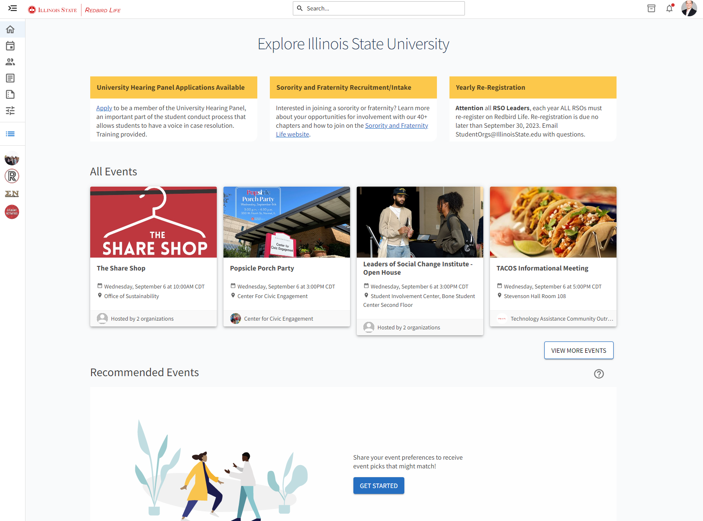
Redbird Life - Overview
Access your RSO
Notes:
Show how to click the icons on the left to access RSO tools

Slide 15
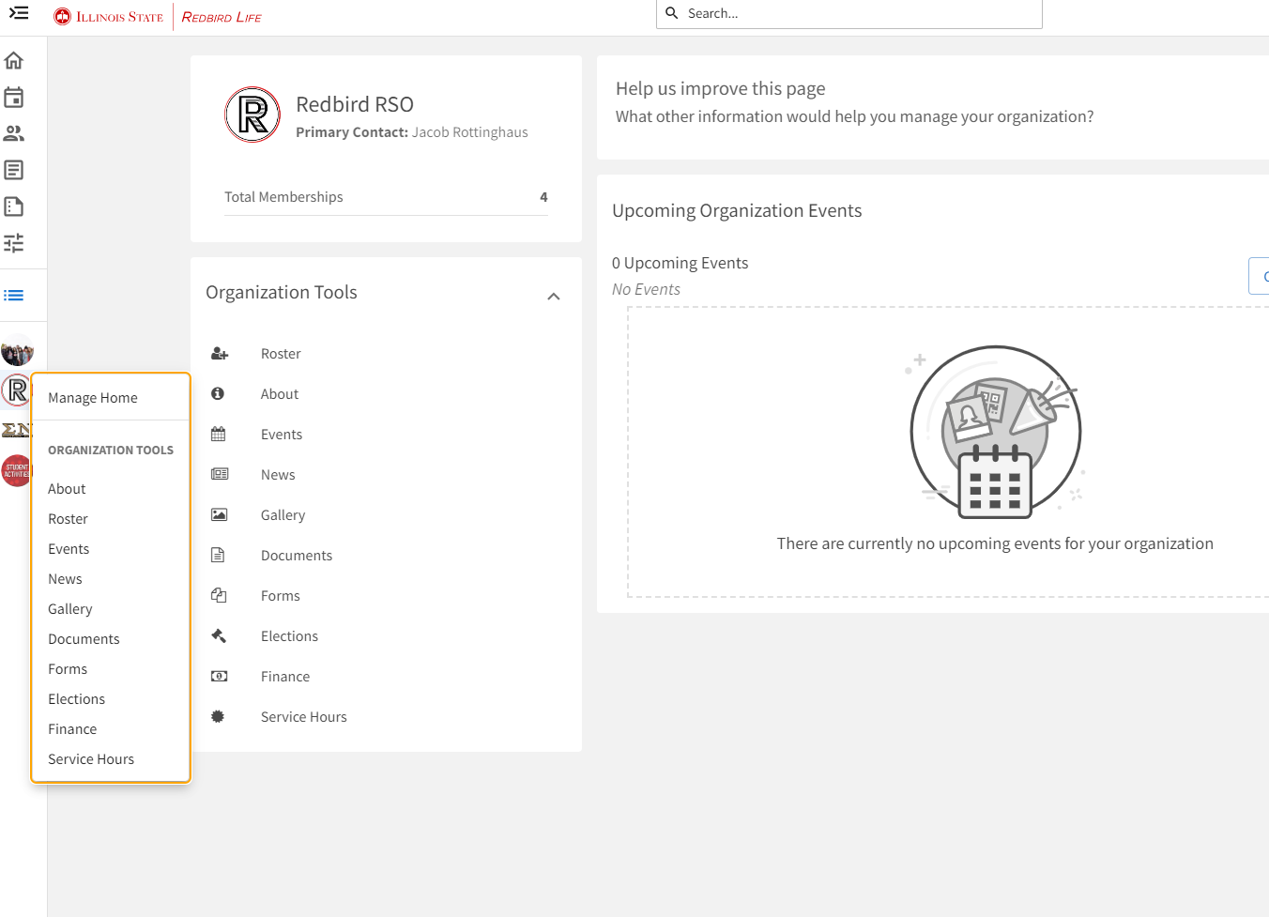

Redbird Life - Overview
Organization Tools
Roster Management
Event Creation
Forms/Signups
News Articles
AND MORE!
Notes:
Show how the tool bar functions
This is also where you would see your “re-registration” link if you needed to complete

Slide 16
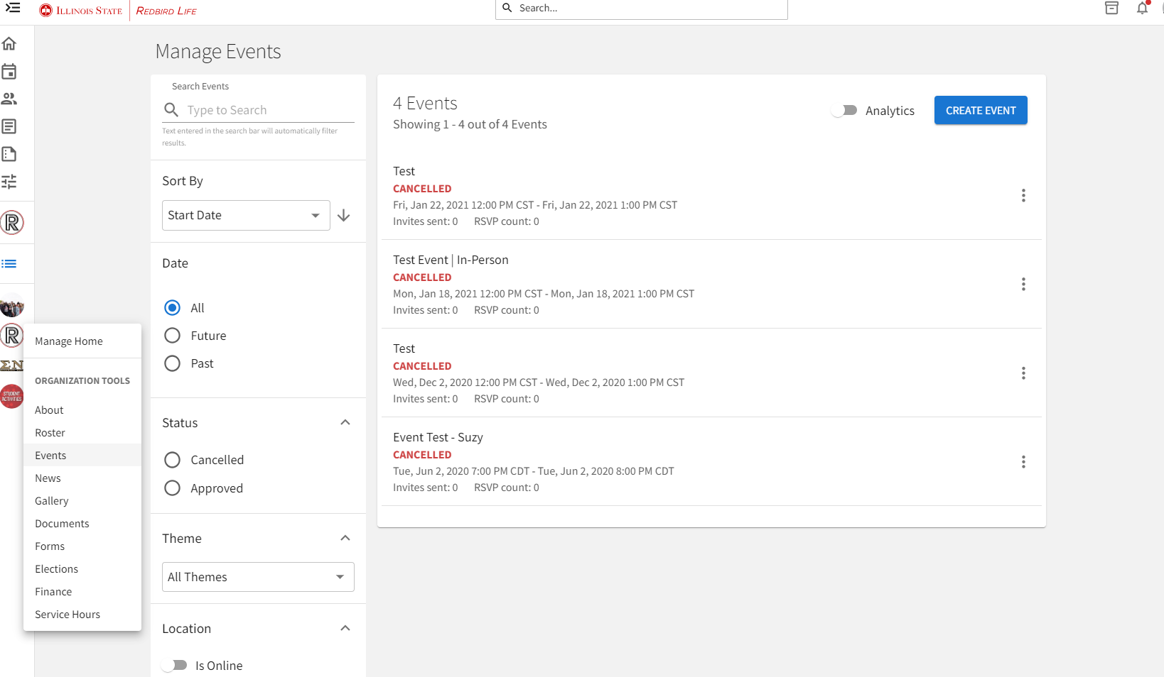
Redbird Life - Events
Create events!
Notes:
Show how to create event
Discuss clicking the blue button
Then go next slide

Slide 17
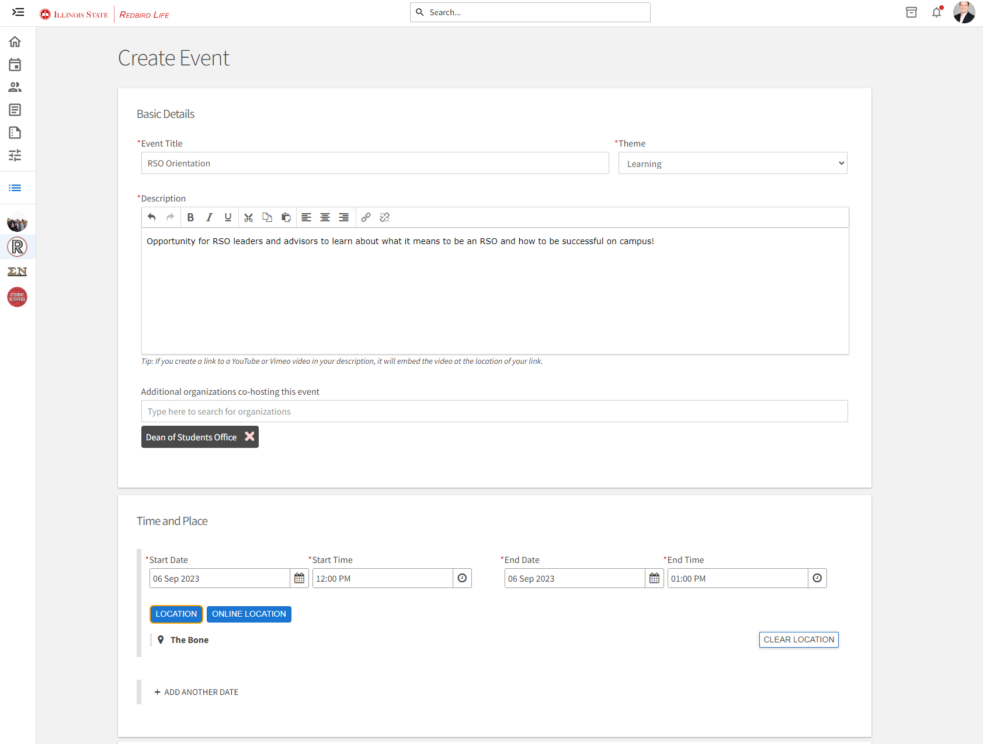
Redbird Life - Events
Notes:
Fill in the details like you would for any form
Remember to tag organizations that you are working with (if any)
This allows for events to show on your page and theres

Slide 18
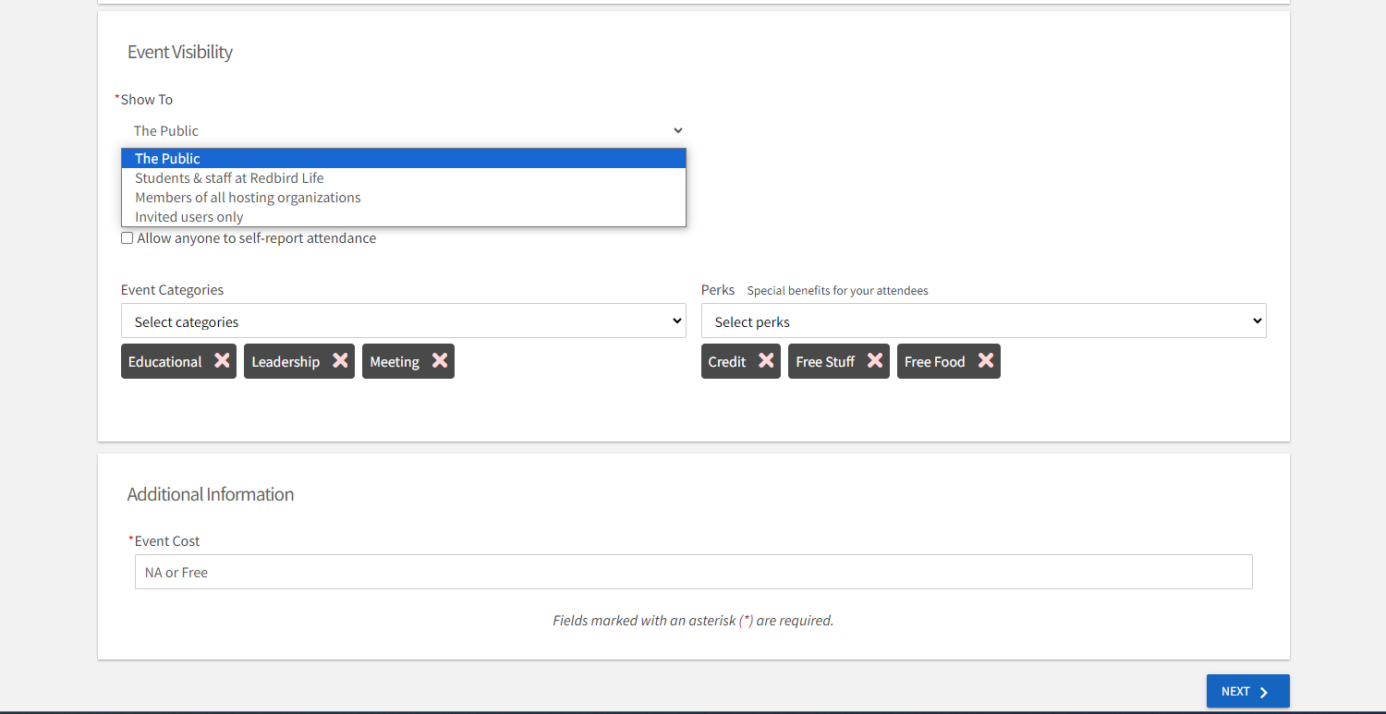
Redbird Life - Events
Notes:
Can set visibility based on options
Discuss ooptions
Categories are important for students searching Redbird Life by topic are
Set the cost if applicable

Slide 19
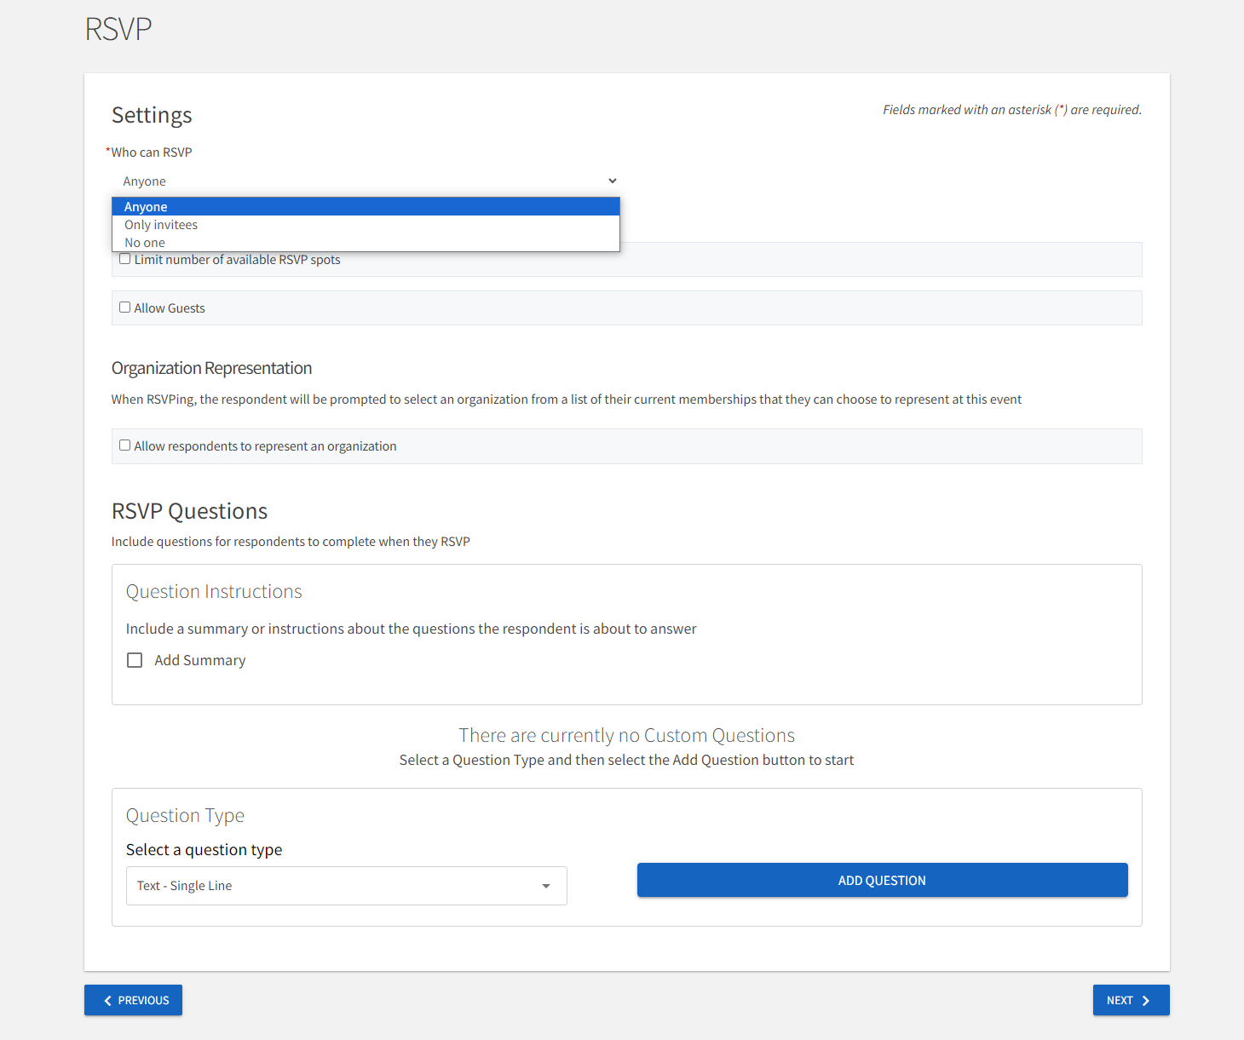
Redbird Life - Events
Notes:
Set RSVP based on what you want
Could ask questions ahead of time like pronouns, or dietary restrictions

Slide 20
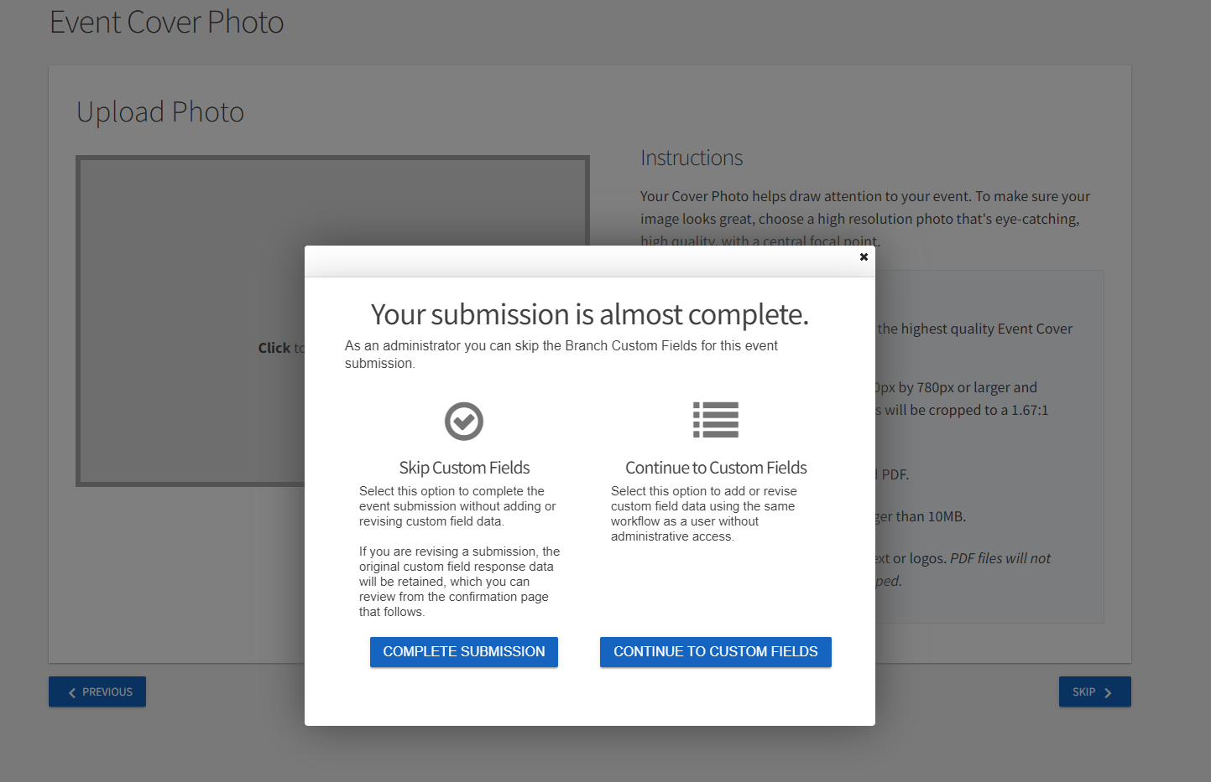
Redbird Life - Events

Slide 21
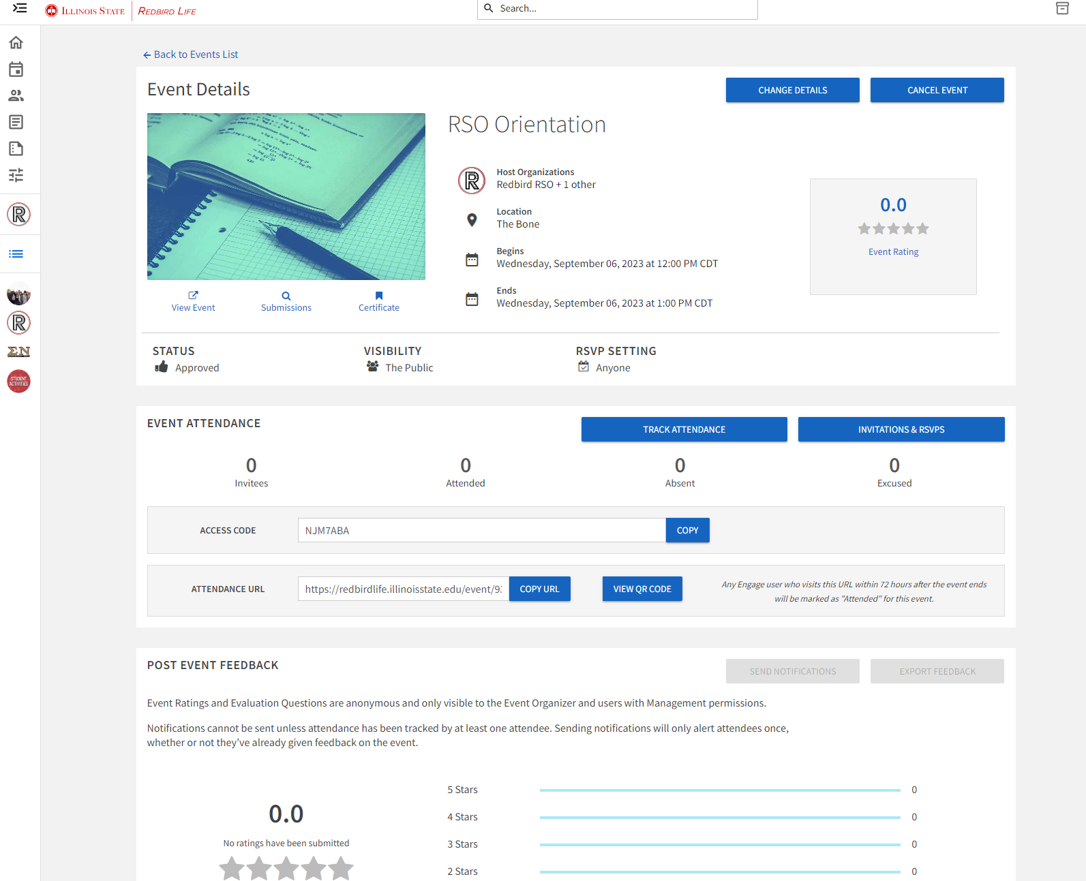
Redbird Life - Events
Notes:
Invitations & RSVP
Can see who is attending and their status of their RSVP
Event Pass
- Can track attendance via a self check-in code or with event pass

Slide 22
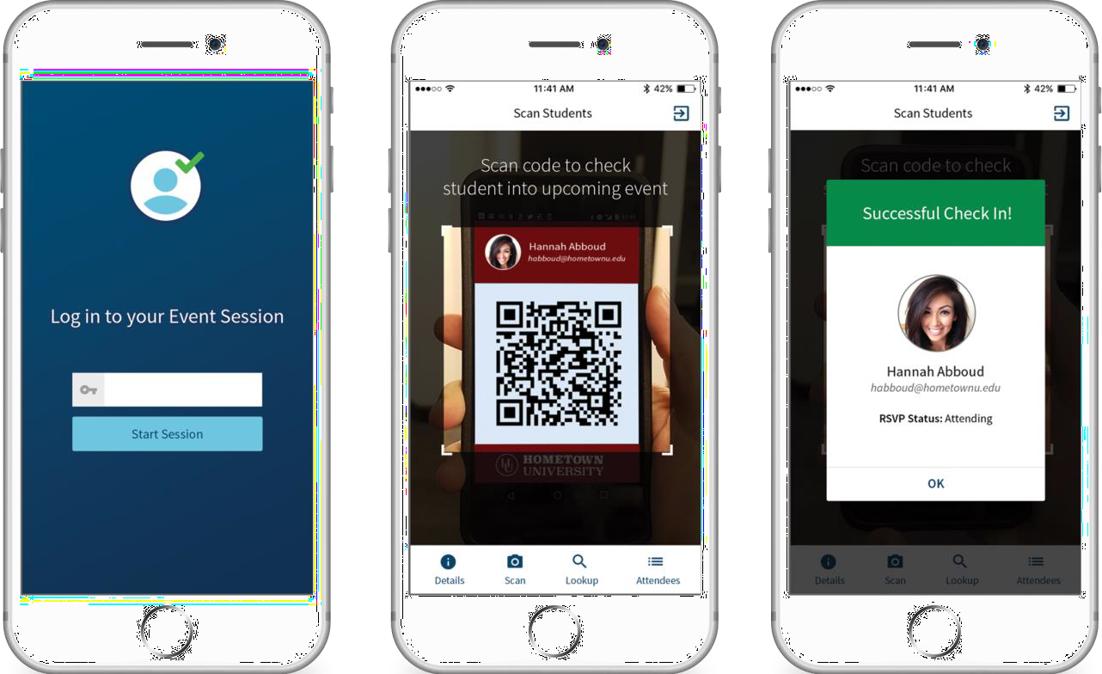
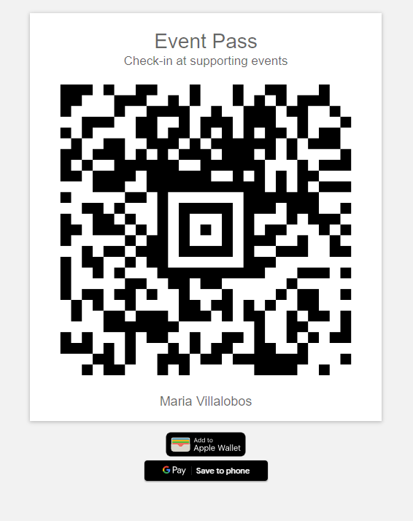


Redbird Life
Attendance at Events
Download Event Check-in App!
Learn more on the Student Organizations website:
deanofstudents.illinoisstate.edu/involvement/organizations/resources

Slide 23
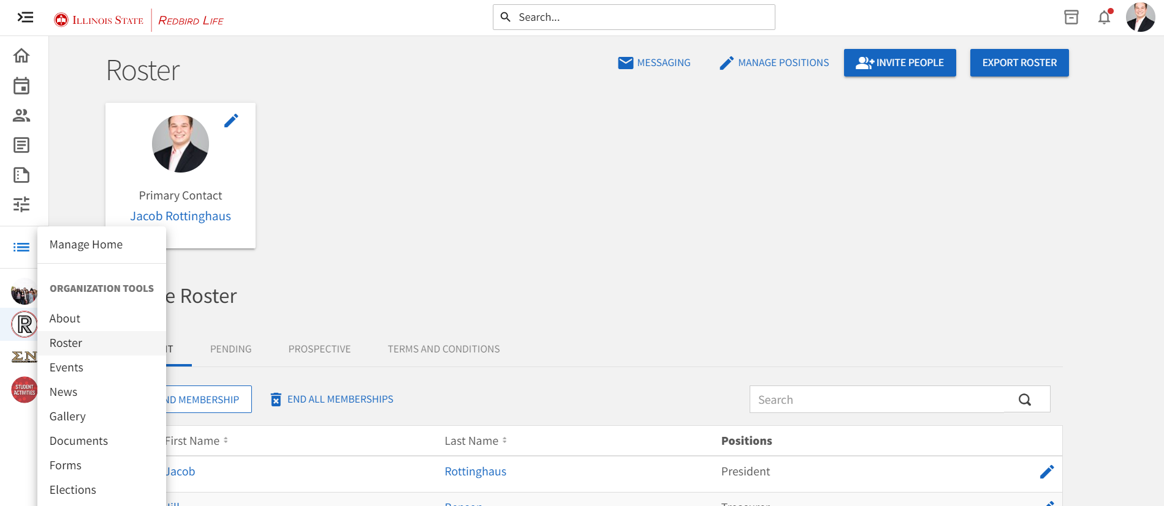
Redbird Life - Roster
Notes:
Edit the roster after the elections of new officers
Can invite new members
Can see members interested in joining
Can email message all on roster (note the campus policy on mass emails)

Slide 24
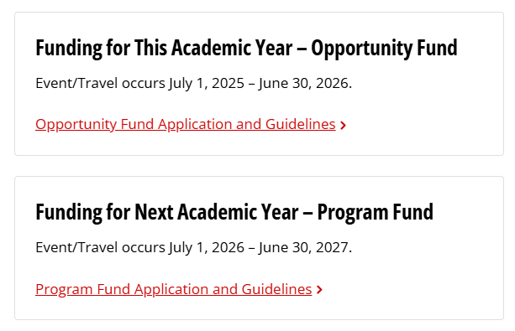
RSO Funding
Funding
Independent RSOs
Sponsored RSOs
Certain limitations
Contact
Heather Marshall
  RSO Financial Associate
  hllough@IllinoisState.edu

Slide 25
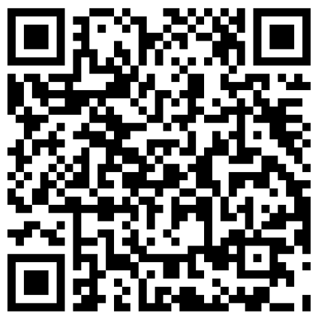
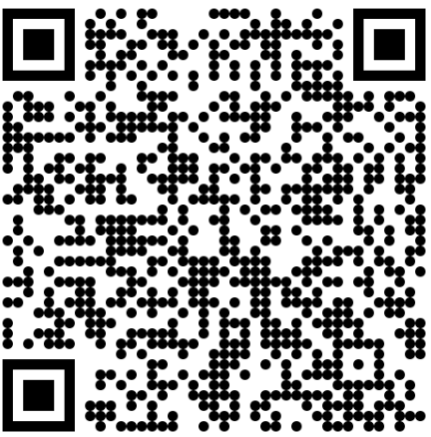
Booking Rooms on Campus
The Bone Student Center
Reserving Space
MUST have a booking privileges form on file with the Bone Student Center
Submit an event reservation request via the online booking form
Pay attention to your University email for messages from Event Management, Dining & Hospitality staff regarding your reservation
Reserve
Booking Access
Learn more at the Bone Student Center Website:
bonestudentcenter.illinoisstate.edu/scheduling

Slide 26
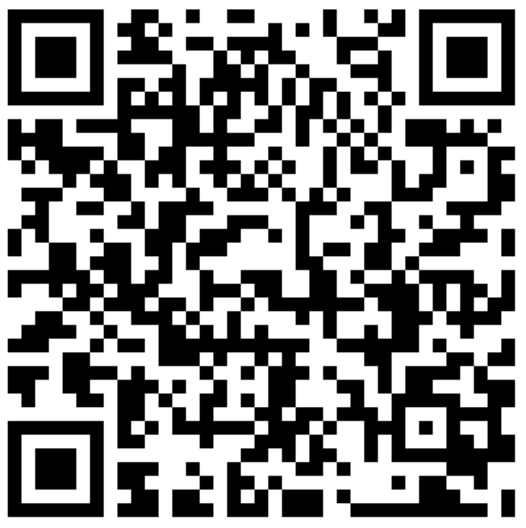
Booking Rooms on Campus
Academic & Non-Academic Spaces
Reserving Space
Spaces to Reserve
Contact Conference Services
Review the options
Email or call the appropriate person
Receive room confirmation and details
Enjoy your event!
Conference Rooms
Classrooms
Lecture Halls
Space on the Quad
Tabling locations
Learn more at the Bone Student Center Website:
conferences.illinoisstate.edu/scheduling/
Scan to Access

Slide 27
Frequently Asked
Why was my re-registration denied?
Non-discrimination clauses – need to be updated
Membership – needs to say 100% of members are from ISU
Ratification date – must be within the last two years
When can I expect to hear a status update?
It may take our office up to fifteen (15) business days

Slide 28

Need Assistance?
Feel a little lost…or want more info on an RSO topic?
We can meet with you and/or your RSO for a more in-depth discussion based on your RSO’s needs!
CONTACT US
Email: StudentOrgs@IllinoisState.edu
Or
Phone: (309) 438-2151

Slide 29


Dean of Students Office
387 Student Services Building
(309) 438-2008
DeanOfStudents.IllinoisState.edu
Redbird_Life
RedbirdLifeISU

Slide 30
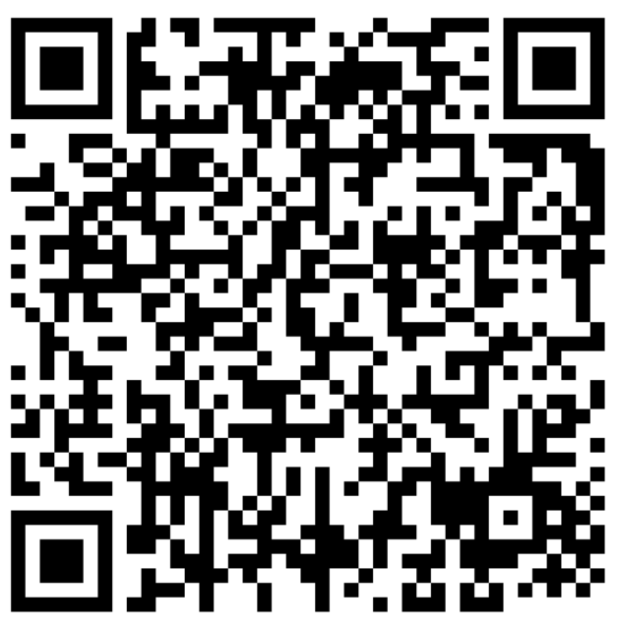
Student Navigators
Student-led, peer-to-peer program for ISU students facing economic hardship and basic needs crisis
Navigators connect students to resources, including:
  Emergency aid
  Food
  Housing
  Textbooks
  Health
  And more!
Contact:
Phone: (309) 438-2008
Email: DeanOfStudents.IllinoisState.edu
Web: About.IllinoisState.edu/basicneeds
Scan to Access
https://deanofstudents.illinoisstate.edu/services/student-navigator/

Slide 31
Give us a follow
Learn about…
Student Organizations
Events
Campus programs
Food venues
Well-being
And more…
Redbird_Life
Redbird_Food
Redbird_Well

Slide 32


