Slide 1
RSO Orientation
2024-2025

Slide 2
Agenda
Topic Areas
General Resources & Support
RSO Calendar
Campus Policies
Code of Student Conduct
Redbird Life
RSO Funding
Reserving Space on Campus
How to get support

Slide 3
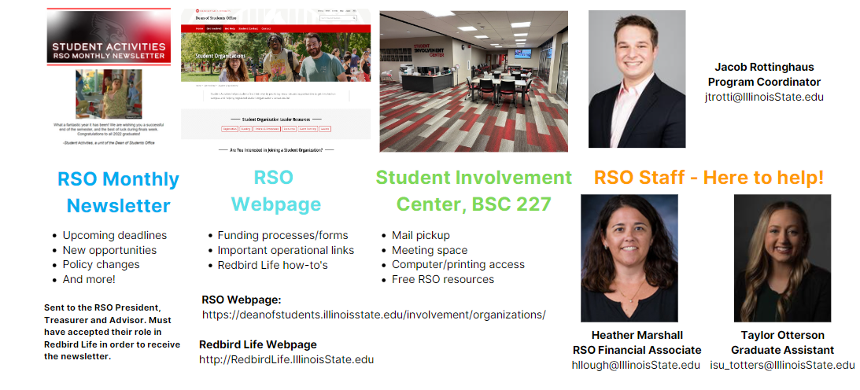
Stay Informed

Slide 4
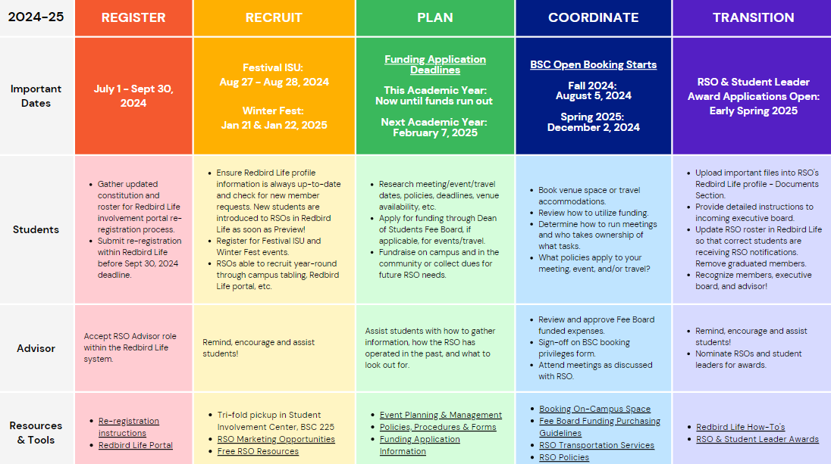
RSO Calendar

Slide 5
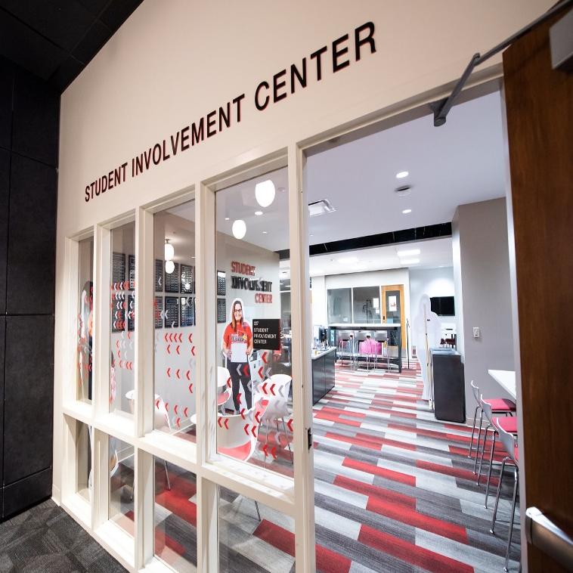
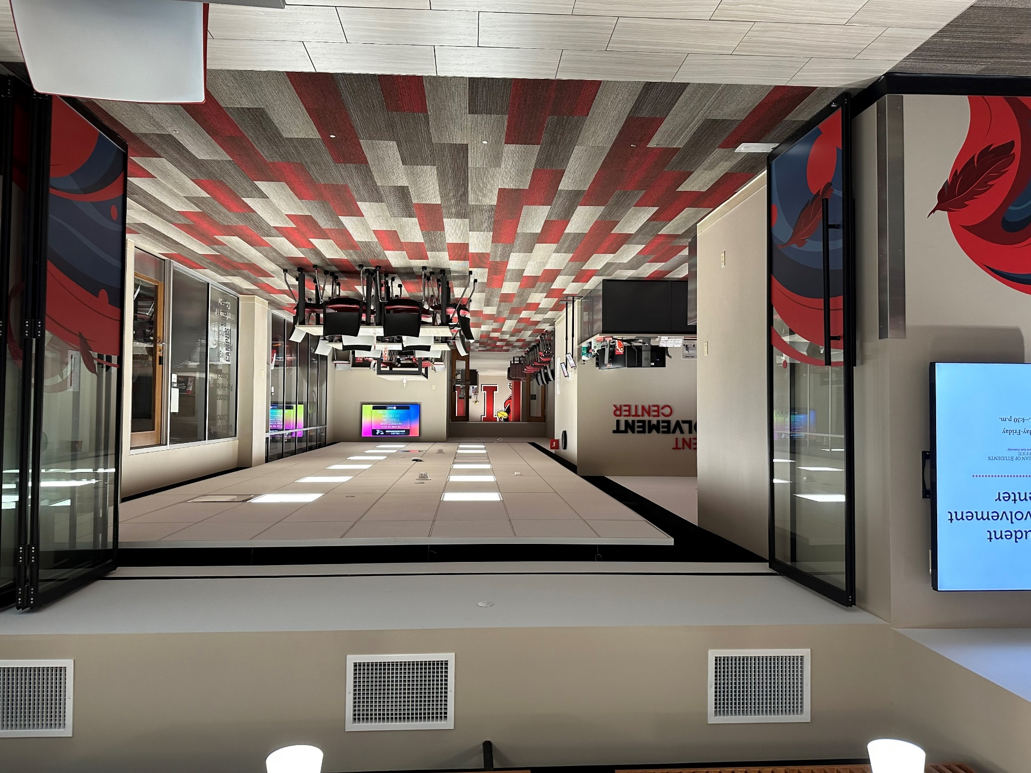
Student Involvement Center
In the Bone Student Center

Slide 6
FREE – RSO Resources
Supplies
Trifold – 1 per RSO/year
Pens
Mini Pads of Paper
Art Supply Kits
Chalk the Quad Kits
Board Games
Student Involvement Center
Fall & Spring: M – F 8 am to 6 pm
Summer: M – F 8 am to 4:30 pm
Computers with Adobe Creative Suite
Conference Table Space with a Large Screen
15 Copies per RSO/Day
24 Customized Buttons per RSO/semester
RSO Mail Pick-up (held for 30 days)
Bulk Paper Cutter
General Table Seating
Digital Marketing
Digital Display Screens
Outside Student Involvement Center
RSO Newsletter
Redbird Life Portal
Notes:
Highlight some of the resources

Slide 7
Campus Policies & Procedures
Policies to Acknowledge
Amplification
Contract
Event Insurance
Event Promotion
Events with Alcohol
Film copyright/subtitles
Fleet
Food Permits
Funding/Fundraising
External Bank Accounts
Protection of Minors on Campus
Raffles
RSO Classification
Space reservation and use
For more information, see the Student Organizations website
deanofstudents.illinoisstate.edu/involvement/organizations/policies
To review the specific policies and expectations, see the University Policies website
policy.illinoisstate.edu

Slide 8
Campus Policies & Procedures
Policy 6.1.1 - Space Reservation & Use
The quad is available for general use but requires a reservation for events/activities sponsored/hosted by RSOs.
Classrooms, meeting facilities, theatres and auditoriums, athletic and recreational facilities, and other outdoor University spaces typically require advance registration.
The University will not interfere unless participants engage in the following behaviors:
Disrupt or prevent a function or activity
Injure persons, damage or destroy property, or threaten to cause injury
Create safety hazards or jeopardize the safety of others
Construct structures on university grounds without prior authorization
For more information, see the Student Organizations website
deanofstudents.illinoisstate.edu/involvement/organizations/policies
To review the specific policies and expectations, see the University Policies website
https://policy.illinoisstate.edu/facilities/6-1-1/

Slide 9
Code of Student Conduct
*This applies to Individuals & RSOs*
Complete Code of Student Conduct available at deanofstudents.illinoisstate.edu/conduct/code
Stop by:
Student Conduct and Community Responsibilities
Student Services Building, Office 120
Contact:
Phone: (309) 438-8621
Email: SCCRHelp@IllinoisState.edu
Scan to Access
The Code of Student Conduct

Slide 10
Code of Student Conduct
Hazing
Page 11:
V iolations include such behavior as:
Engaging in any act that endangers the mental, emotional, or physical health or safety of a student for the purpose of initiation into, affiliation with, or continued membership in any group, organization, or team whose members are or include students of Illinois State University.
Engaging in any act where an individual is encouraged to engage in conduct of an unbecoming or humiliating nature, or which in any way detracts from an individual’s academic pursuits for the purpose of initiation into, affiliation with, or continued membership in any group, organization, or team whose members are or include students of Illinois State University.
Engaging in any acts such as paddling (using a paddle to strike another individual), physical punishments, creating excessive fatigue, work sessions, physical or emotional shock, wearing apparel which is conspicuous and not in good taste, public stunts, morally degrading or humiliating games or events, of that encourage the illegal and/or abusive use of alcohol and/or other drugs.
Failing to prevent, and/or failing to discourage, and/or failing to report known acts of hazing as a member of an organization participating in such activities when these activities are known to be taking place, or where it should be reasonably known that such activities are taking place.
For the purpose of this policy, hazing includes any activity that is inconsistent with regulations or policies of Illinois State University or the laws of the State of Illinois for the purpose of initiation into, affiliation with, or continued membership in any group, organization, or team whose members are or include students of Illinois State University. Acts of this nature are considered to be hazing whether or not a person willingly participates in such activities.
deanofstudents.illinoisstate.edu/conduct/code

Slide 11
Illinois State Law
Hazing
Statue 12C-50
A person commits hazing when he or she knowingly performs an act, or causes a situation, that recklessly or intentionally subjects a student or other person in a school, college, university, or other educational institution of this State, to the risk of bodily harm for the purpose of induction or admission into any group, organization, or society associated or connected with that institution, if: (1) the act or situation is not sanctioned or authorized by that educational institution; and (2) the act results in bodily harm to any person
deanofstudents.illinoisstate.edu/conduct/code

Slide 12
Conduct – What to Do?
Is it hazing?
Ask the Student Activities Office to review the situation with you.
Consider, what is the value added to your organization/event through the activity?
Need to report hazing or other conduct-related situations?
Make a report to Student Conduct and Community Responsibilities:
ilstu-advocate.symplicity.com/public_report/index.php/pid673310

Slide 13
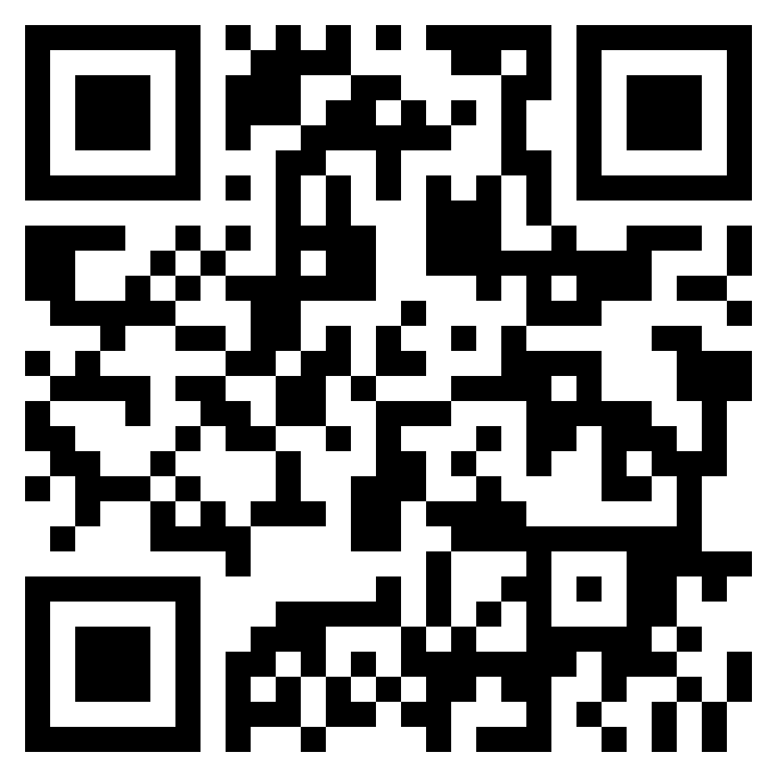
Redbird Life
Scan to Access
https://redbirdlife.illinoisstate.edu/

Slide 14
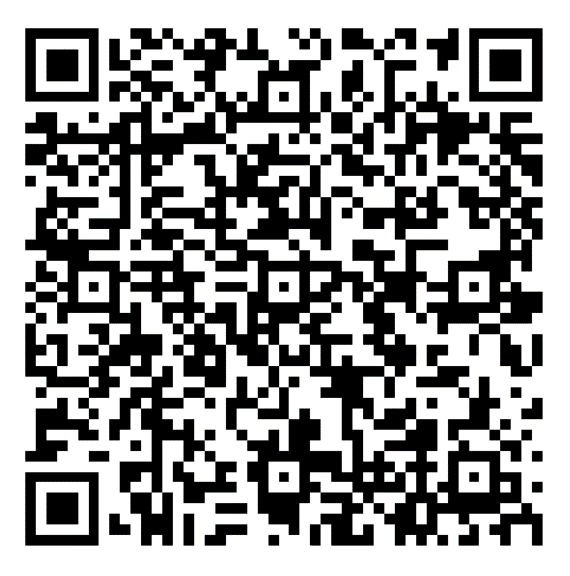
What can I do on Redbird Life?
Features
Roster Management
Event Creation
Attendance tracking
Forms/Signups
News Articles
AND MORE!
Scan to Access
Redbird Life How-To Guide
deanofstudents.illinoisstate.edu/involvement/organizations/resources/#involvement-center|RSO-Resources1

Slide 15
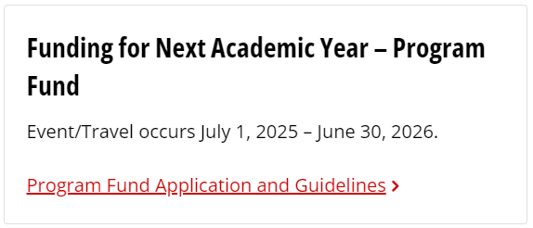
RSO Funding
Funding
Independent RSOs
Sponsored RSOs
Certain limitations
Contact
Heather Marshall
RSO Financial Associate
hllough@IllinoisState.edu
deanofstudents.illinoisstate.edu/involvement/organizations/funding/

Slide 16
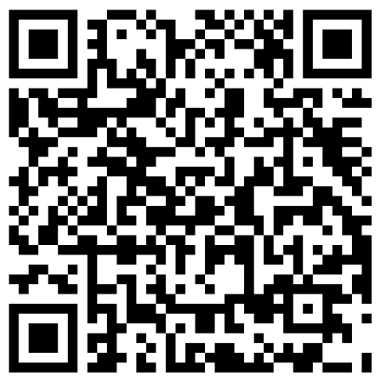
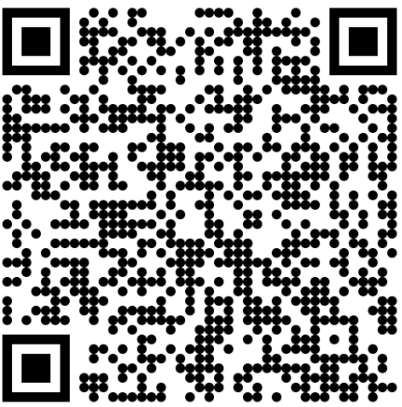
Booking Rooms on Campus
The Bone Student Center
Reserving Space
MUST have a booking privileges form on file with the Bone Student Center
Submit an event reservation request via the online booking form
Pay attention to your University email for messages from Event Management, Dining & Hospitality staff regarding your reservation
Reserve
Booking Access
Learn more at the Bone Student Center Website:
bonestudentcenter.illinoisstate.edu/scheduling

Slide 17
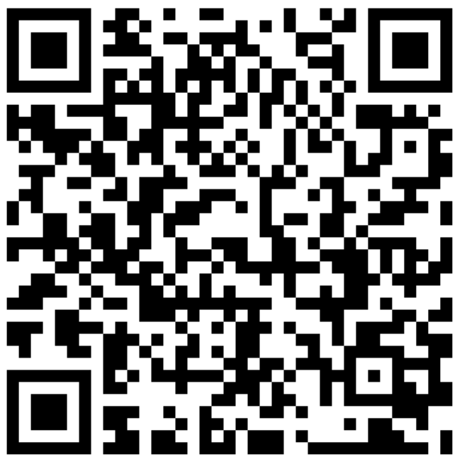
Booking Rooms on Campus
Academic & Non-Academic Spaces
Reserving Space
Spaces to Reserve
Contact Conference Services
Review the options
Email or call the appropriate person
Receive room confirmation and details
Enjoy your event!
Conference Rooms
Classrooms
Lecture Halls
Space on the Quad
Tabling locations
Learn more at the Bone Student Center Website:
conferences.illinoisstate.edu/scheduling/
Scan to Access

Slide 18
Need Assistance?
Feel a little lost…or want more info on an RSO topic?
We can meet with you and/or your RSO for a more in-depth discussion based on your RSO’s needs!
CONTACT US
Email: StudentOrgs@IllinoisState.edu
Or
Phone: (309) 438-2151

Slide 19
Dean of Students Office
387 Student Services Building
(309) 438-2008
DeanOfStudents.IllinoisState.edu
Redbird_Life
RedbirdLifeISU

Slide 20
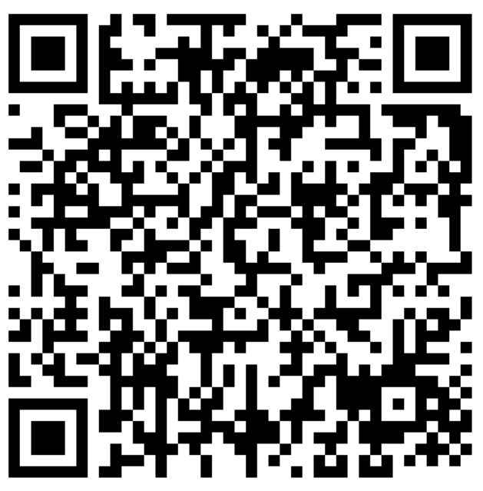
Student Navigators
Student-led, peer-to-peer program for ISU students facing economic hardship and basic needs crisis
Navigators connect students to resources, including:
Emergency aid
Food
Housing
Textbooks
Health
And more!
Contact:
Phone: (309) 438-2008
Email: DeanOfStudents.IllinoisState.edu
Web: About.IllinoisState.edu/basicneeds
Scan to Access
https://deanofstudents.illinoisstate.edu/services/student-navigator/

Slide 21
Give us a follow
Learn about…
Student Organizations
Events
Campus programs
Food venues
Well-being
And more…
Redbird_Life
Redbird_Food
Redbird_Well

