Slide 1
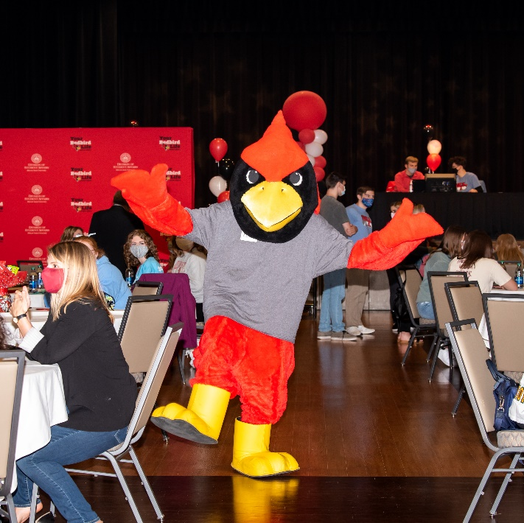
RSO
Orientation 2024-2025

Slide 3
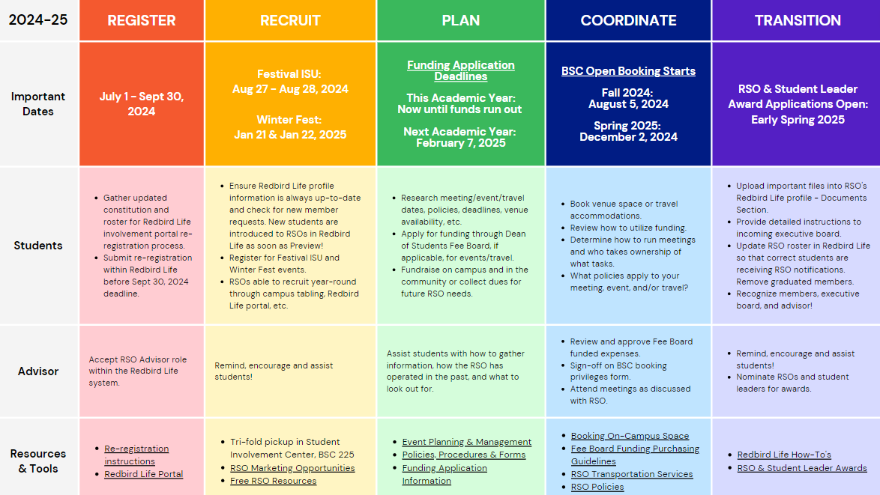
2024-2025 RSO Calendar

Slide 4
Campus Policies/Procedures
Amplification
Contracts
Event Insurance
Event promotion
Events with Alcohol
Film copyright/subtitles
Fleet
Food Permit
Funding / Fundraising
Open External Bank Account
Protection of Minors on Campus
Raffles
RSO Classification
Space reservation
For more information, visit our:
Policies and Procedures webpage -
https://deanofstudents.illinoisstate.edu/involvement/organizations/forms/
Event Planning webpage–
https://deanofstudents.illinoisstate.edu/involvement/organizations/event-planning/

Slide 5
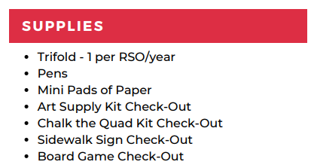
FREE RSO RESOURCES

Slide 6
Student Involvement Portal

Slide 7
How to Use Redbird Life
Access your RSO

Slide 8
How to Use Redbird Life
This is where you can navigate to different parts of your RSO’s Redbird Life profile.

Slide 9
How to Use Redbird Life
Track attendance at your meetings and events.
Download Event Check-in App!
Learn more at the Student Organizations Resources webpage:
https://deanofstudents.illinoisstate.edu/involvement/organizations/resources/

Slide 10
Code of Conduct
Applies to Individuals & RSOs
Page 5: Interim Actions for Student Organizations
The University reserves the right to impose an interim disciplinary suspension on a registered student organization when the interim action is needed to:
Ensure the safety and well-being of members of the University community
or preservation of University property; and/or
Alleviate a threat that a student organization poses to the disruption of or interference with the normal operations of the University.
The Vice President for Student Affairs (VPSA) or their designee shall be responsible for the determination of interim suspensions and any other interim restrictions, including but not limited to activity restrictions, restrictions from contacting specific individuals and/or restrictions from specific University locations. During an interim suspension, a student organization may not engage in any organized activities.
Complete Code of Student Conduct available at https://deanofstudents.illinoisstate.edu/conduct/code/

Slide 11
Code of Conduct
Applies to Individuals & RSOs
Page 3:
The Code and the student conduct process shall apply to the academic and social conduct of individual students, both undergraduate and graduate, and all Registered Student Organizations.
Students who are members of registered student organizations may be subject to jurisdiction both as an individual student and as a member of the student organization.
The Code applies to behaviors that take place on-campus, at University sponsored events and activities, in online or hybrid courses connected to Illinois State University, and off-campus, when the off campus behavior impacts
University interests. Students attending a function as a representative of the
University (including, but not limited to, students on academic or athletic teams, students involved in internships, and students participating in exchange or study abroad programs) are subject to the Code.
The Code may be applied to behavior conducted online, via email, text messages, or other electronic medium. Students should be aware that online postings such as social media sites, blogs, web posting, and chat rooms are in the public sphere and are not private. Action may be taken for online activity when the behavior violates the Code.

Slide 12
Code of Conduct
Hazing
Page 11:
V iolations include such behavior as:
Engaging in any act that endangers the mental, emotional, or physical health or safety of a student for the purpose of initiation into, affiliation with, or continued membership in any group, organization, or team whose members are or include students of Illinois State University.
Engaging in any act where an individual is encouraged to engage in conduct of an unbecoming or humiliating nature, or which in any way detracts from an individual’s academic pursuits for the purpose of initiation into, affiliation with, or continued membership in any group, organization, or team whose members are or include students of Illinois State University.
Engaging in any acts such as paddling (using a paddle to strike another individual), physical punishments, creating excessive fatigue, work sessions, physical or emotional shock, wearing apparel which is conspicuous and not in good taste, public stunts, morally degrading or humiliating games or events, of that encourage the illegal and/or abusive use of alcohol and/or other drugs.
Failing to prevent, and/or failing to discourage, and/or failing to report known acts of hazing as a member of an organization participating in such activities when these activities are known to be taking place, or where it should be reasonably known that such activities are taking place.
For the purpose of this policy, hazing includes any activity that is inconsistent with regulations or policies of Illinois State University or the laws of the State of Illinois for the purpose of initiation into, affiliation with, or continued membership in any group, organization, or team whose members are or include students of Illinois State University. Acts of this nature are considered to be hazing whether or not a person willingly participates in such activities.

Slide 13
Illinois State Law
Hazing
Statue 12C-50
A person commits hazing when he or she knowingly performs an act, or causes a situation, that recklessly or intentionally subjects a student or other person in a school, college, university, or other educational institution of this State, to the risk of bodily harm for the purpose of induction or admission into any group, organization, or society associated or connected with that institution, if: (1) the act or situation is not sanctioned or authorized by that educational institution; and (2) the act results in bodily harm to any person

Slide 14
What Do I do?
Hazing
Unsure if it’s hazing?
Ask the Student Activities Office to review the situation.
Consider what value is added to your organization/event through the activity?
Need to report hazing?
If you believe there is hazing happening in your group, report it to
Student Conduct and Community Responsibilities at:
https://ilstu-advocate.symplicity.com/public_report/index.php/pid673310

Slide 15
Need Assistance?
Feel a little lost…or want more info on an RSO topic?
We can meet with you and/or your RSO for a more in-depth discussion based on your RSO’s needs!
CONTACT US
Email: studentorgs@IllinoisState.edu
Or
Phone: (309) 438-2151

Slide 16
Questions?
Student Activities Office Contact Information
Website: Deanofstudents.illinoisstate.edu/involvement/organizations
Email: StudentOrgs@IllinoisState.edu
Phone Number: (309) 438-2151
Student Involvement Center:
227 Bone Student Center
August – May,
Monday-Friday: 8am-6pm
Social Media:
Facebook: Redbird Life
Instagram: redbird_life

