Slide 1
Sponsored Registered Student Organization Advisor Orientation
Dean of Students Office
2023-2024

Slide 2
What it Means to be a Sponsored RSO
The purpose and operations of the RSO are considered integral and inherently linked to a specific department/school and/or the University.
The sponsoring department/school has approval and decision-making authority and will include a statement in the RSO constitution/by-laws stating as such.
The department/school, through the advisor, provides oversight to the RSO. The department/school leadership- has approval and denial authority for RSO activities.
The advisor meets with the RSO on a regular basis and is well-versed on the current and proposed activities of the RSO. In accordance with University policy, authorized signers for the department/school will request and sign all contractual agreements for all RSO events/activities.

Slide 3
What it Means to be a Sponsored RSO
The department/school is obligating the University to assume liability for RSO activities.
The department/school may be held financially responsible/liable for claims incurred by the University as a result of RSO activities.
Can have a financial account on campus even for self-generated fees.
Can utilize the University’s tax-exempt number when uses funds housed in University account.
Can utilize University purchasing card.
Contracts for performers/vendors can exceed $4,999.
Events may be covered by the University’s general liability insurance.
Must follow University procedures.

Slide 4
Advising Registered Student Organizations

Slide 5
STAY INFORMED!

Slide 6
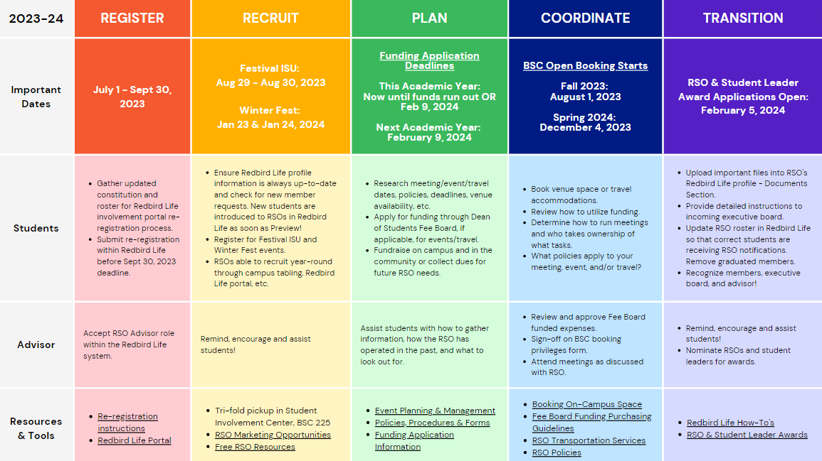
2023-2024 RSO Calendar

Slide 7
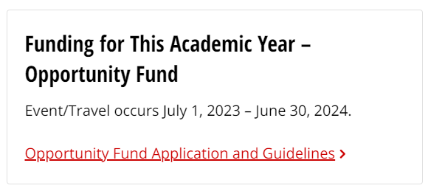
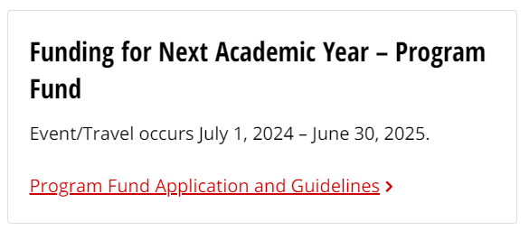
RSO Funding
Did you know?
Funding
Independent RSOs
Sponsored RSOs
Certain limitations
Contact
Heather Marshall
RSO Financial Associate
hllough@IllinoisState.edu

Slide 8
FREE RSO Resources
Supplies
Trifold – 1 per RSO/year
Pens
Mini Pads of Paper
Art Supply Kits
Chalk the Quad Kits
Board Games
Student Involvement Center
Fall & Spring: M – F 8 am to 6 pm
Summer: M – F 8 am to 4:30 pm
Computers with Adobe Creative Suite
Conference Table Space with a Large Screen
15 Copies per RSO/Day
24 Customized Buttons per RSO/semester
RSO Mail Pick-up (held for 30 days)
Bulk Paper Cutter
General Table Seating
Digital Marketing
Digital Display Screens
Outside Student Involvement Center
RSO Newsletter
Redbird Life Portal

Slide 9
Campus Policies/Procedures
Amplification
Contracts
Event insurance
Event promotion
Events with Alcohol
Film copyright/subtitles
Fleet
Food permit
Funding / Fundraising
Open External Bank Account
Protection of Minors on Campus
Raffles
RSO Classification
Space reservation
For more information, visit our:
Policies & Procedures webpage -
https://deanofstudents.illinoisstate.edu/involvement/organizations/policies/
Event Planning webpage–
https://deanofstudents.illinoisstate.edu/involvement/organizations/event-planning/

Slide 10
Redbird Life, Student Involvement Portal

Slide 11
Redbird Life
RSO Features
Create events & track attendance.
RSO document storage.
Roster management:
Invite prospective members to join.
Update officers/advisors outside of annual re-registration process.
Messaging to members.
How-To Instructions
Redbird Life resources section or https://deanofstudents.illinoisstate.edu/involvement/organizations/resources/

Slide 12
Redbird Life
Advisor Requirement
Accept role within Redbird Life portal.
This will ensure you receive all pertinent RSO messaging.
Step 1

Slide 13
Redbird Life
Step 2
Step 3

Slide 14
Redbird Life
Step 4

Slide 15
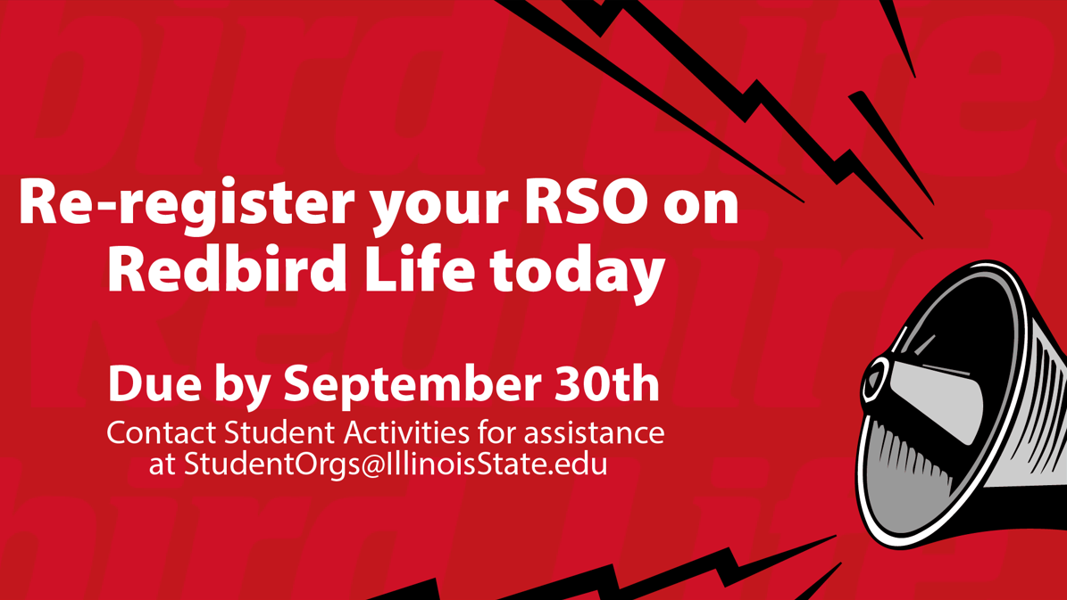
Redbird Life – Re-Registration

Slide 16
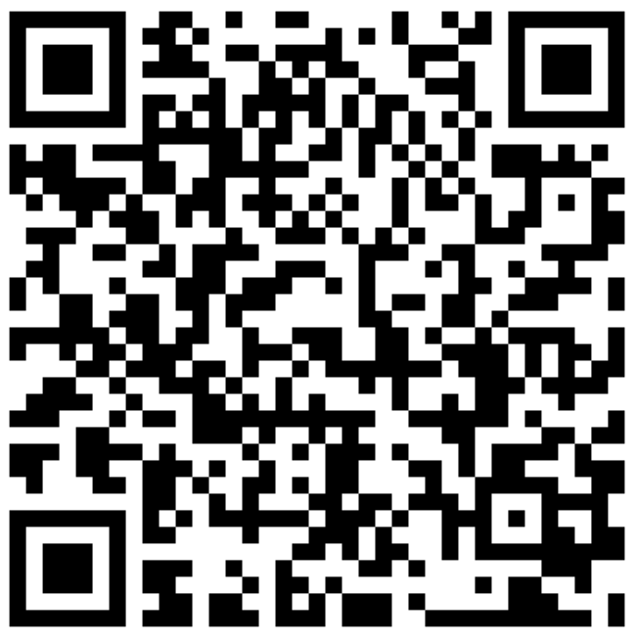
Reserve Space
Academic & Non-Academic Rooms
Reserving Space
Contact Conference Services
Review the options
Email or call the appropriate person
Receive room confirmation and details
Enjoy your event!
Learn more at the Conference Services webpage:
https://conferences.illinoisstate.edu/scheduling/

Slide 17
Questions?

Slide 18
HELP!
Feel a little lost…or want more info on an RSO topic?
We can meet with you and/or your RSO for a more in-depth discussion based on your RSO’s needs!
Email Jacob at jtrotti@IllinoisState.edu to get started

Slide 19
Student Activities Office Contact Information
Website: Deanofstudents.illinoisstate.edu/involvement/organizations
Email: StudentOrgs@IllinoisState.edu
Phone Number: (309) 438-2151
Student Involvement Center:
227 Bone Student Center
August – May,
Monday-Friday: 8am-6pm
Facebook: Redbird Life
Instagram: Redbird_Life

Slide 20
Thank you!
We can’t wait to see all the amazing things you accomplish this year!

